Slide 2


Dr MUSA GUMEDE
Chief Executive & Registrar
Council for Medical Schemes
Enhancing Member Value Through Innovation

Slide 3
Outline
Mandate & Functions of Council
Defining Value for Members
Access/ Affordability/Quality
Benefit enhancement
Member Education and informed decision making
Contracting and Outsourcing
Concluding remarks

Slide 4
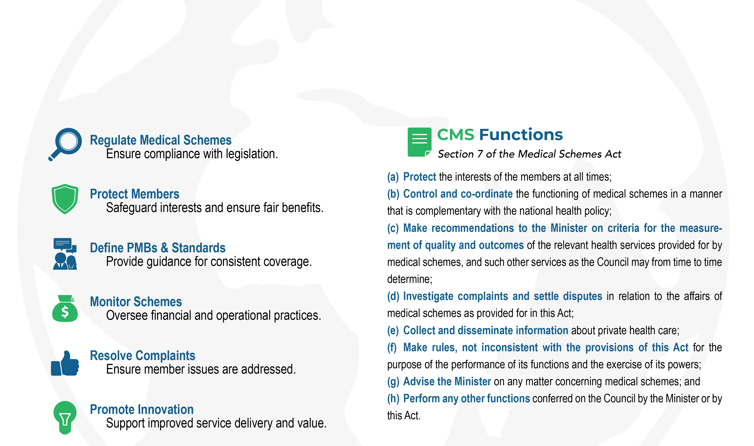
Mandate & Functions of Council

Slide 5
What is ‘value’ for members of schemes?
Value for Members
The extent to which a medical scheme provides comprehensive and equitable access to quality healthcare services while ensuring financial protection and affordability.
Financial Protection
Minimising the risk of catastrophic out-of-pocket expenses and ensuring predictable, manageable contributions.
Value for Money
Ensuring that the cost of contributions reflects the quality and range of benefits received, including preventive, curative, and wellness services.
Health Outcomes
Delivering tangible improvements in members’ health.
Equity and Access
Ensuring all members can access appropriate care without discrimination or barriers.
“The extent to which a medical scheme provides comprehensive and equitable access to quality healthcare services while ensuring financial protection, affordability, and optimal use of contributions, thereby delivering measurable health outcomes and cost-effectiveness to its beneficiaries.”

Slide 6
Value for money
ACCESS
AFFORDABILITY
QUALITY
Optimise Networks Efficient DSP contracts reduce barriers to care.
Fair Premiums: Regulatory oversight ensures benefits align with costs.
Invest in Quality Provider networks, technology, and monitoring enhance care.
Quick Access
Innovative Care
Minimise treatment delays for members.
Smart contracting and new delivery models cut long-term costs.
Defined Coverage
Monitoring
CMS sets mandatory benefits to protect members.
Ensures schemes maintain fairness and transparency.
Premium Impact
Long-Term Savings Preventing complications reduces future costs.
High-quality care may raise short-term premiums.

Slide 7
Benefit Enhancement
Standardised & Simplified Benefits- Provide consistent, easy-to-understand coverage.
Benefit Enhancement - Add valuable services or treatments.
Improved Communication- Clearly inform members about entitlements.
Technology & Digitisation - Streamline access and administration through digital tools.
Product Training - Equip staff to manage and explain benefits effectively.
Funding Ambiguity - Address unclear funding mechanisms to ensure sustainability and transparency.
CMS Guidance
Align benefits with real member needs.
Follow CMScripts for consistent administration.
Adhere to Prescribed Minimum Benefit (PMB) definitions.
Premium Increase Justification - Annual Contribution Increase Guidance Note.

Slide 8
Member education & informed decision-making
Educate
Educate members on benefits, entitlements, and scheme processes.
Explain
Explain pre-authorisation, claims submission, complaints, and appeals procedures.
Provide
Provide clear guidance on DSPs, provider networks, and service coverage.
Enable
Enable informed choices, reducing unnecessary claims and improving health outcomes.
Support
Support schemes in managing costs and operational risks.
Leverage
Leverage technology to provide easy-to-access information, track claims, and streamline interactions.

Slide 9
Issues to address
Strike a balance between shrinking benefits and increasing costs
Review cost of hospital care to understand the high-cost burden of care
Address misconception of members' understanding their role – Participative membership
Multi-Disciplinary Team service for value, contract for GPs as gatekeepers pay for outcomes
Data analysis by scheme, risk stratify to provide more preventative innovative interventions, that are evidence based.
Member Education, simplified understandable standardised benefit options

Slide 10
Issues to address (cont)
Encourage collaboration Facilitate collaboration between healthcare providers, payers, and members, understanding their entitlement and when to motivate, share evidence-based practice, to reduce costs and improve patient outcomes.
Contracting & outsourcing
Standardisation contracts, services, and processes to reduce variability, improve quality and control costs
Focus on promotion and prevention of care – Incentivise for extra benefits, that reduce long term costs (screening, wellness, chronic disease management)
Enhance service engagement care coordination, disease management, member engagement to understand the value of preventative care , encourage healthy behaviour
Adopt value-based care models – pay for outcomes
Alternative reimbursement models
Proactive predictive data analysis by scheme, to anticipate affordability or benefit access

Slide 11
Challenges in administration services
CMS study - 2025
CHALLENGES IN ADMINISTRATION
Onboarding and Membership Enrolment: a challenge, especially for direct-paying members
Contribution Collection: particularly with debit orders, protracted process
Claims Payment: complex coding, even a small percentage of errors can create substantial noise
Legacy Systems: integrating new systems with old ones, which are expensive to maintain
Data Ownership & Transfer: legacy system data quality can be an issue, can be friction between administrators
Cost Management & Risk: impact of tariffs, cost per event, and the need for standardisation to unlock value and reduce inefficiencies, making it challenging to maintain cost-effectively
Fraud, Waste, and Abuse (FWA): questioning the integrity of highly trained professionals and managing utilisation effectively
Regulatory Compliance: remaining compliant and up to date is costly, and open to interpretation
Managed Care and Provider Networks: negotiation process to ensure favourable terms for all parties, concerns regarding quantity over quality in network management
General compliance (Regulatory compliance)
Customer services
Information management and data control
System assessment (administration system)
Administrator
Responsibility
Financial management reporting
Member record management
Claims management
Contributions management

Slide 12

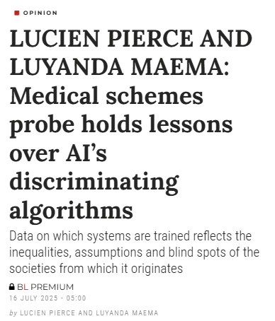
Application of Research: Section 59 - AI Racial Bias
AI Bias in Healthcare: Unveiling the Myth of Neutral Algorithms
Racial Bias in AI Tools: The S59 report reveals that AI tools used by South African medical schemes to detect fraud are perpetuating racial bias against black healthcare providers, challenging the belief that algorithms are neutral
Disproportionate Penalties: Black practitioners are disproportionately investigated and penalised, with data showing they are flagged at higher rates than white counterparts, often without transparent explanations
Global AI Bias Concerns: The report highlights the "black box" effect of AI, where algorithmic processes are opaque, leading to unchallengeable decisions and eroding trust in digital systems
International Examples: Similar biases have been observed globally, such as in the US healthcare system and the Netherlands' tax authority, where AI systems discriminated against minority groups
Need for AI Governance: Experts call for new AI governance standards in South Africa, including algorithmic impact assessments, transparency, and appeal pathways to ensure fairness and align with constitutional equality commitments
Caution Against Imported Models: There is a warning against using AI models developed in different socio-economic contexts, as they may carry biases unsuitable for South Africa's diverse population
Commitment to Fair AI Systems: The future of AI in South Africa hinges on a commitment to designing and regulating systems with justice and fairness, beyond mere technological capability

Slide 13
Concluding Remarks
Manage rising costs while maintaining meaningful coverage.
Simplify benefits, inform members, and encourage participative decision-making.
Incentivise prevention, care coordination, and pay-for-outcome models.
Facilitate provider-scheme-member collaboration and standardise contracts and processes.
Enforce the Medical Schemes Act, ensure transparent benefits, and provide efficient resolution of complaints.

Slide 14
Thank you!
Presentation by Dr Musa Gumede
Chief Executive & Registrar
COUNCIL FOR MEDICAL SCHEMES
Email: m.gumede@medicalschemes.co.za

