Slide 2
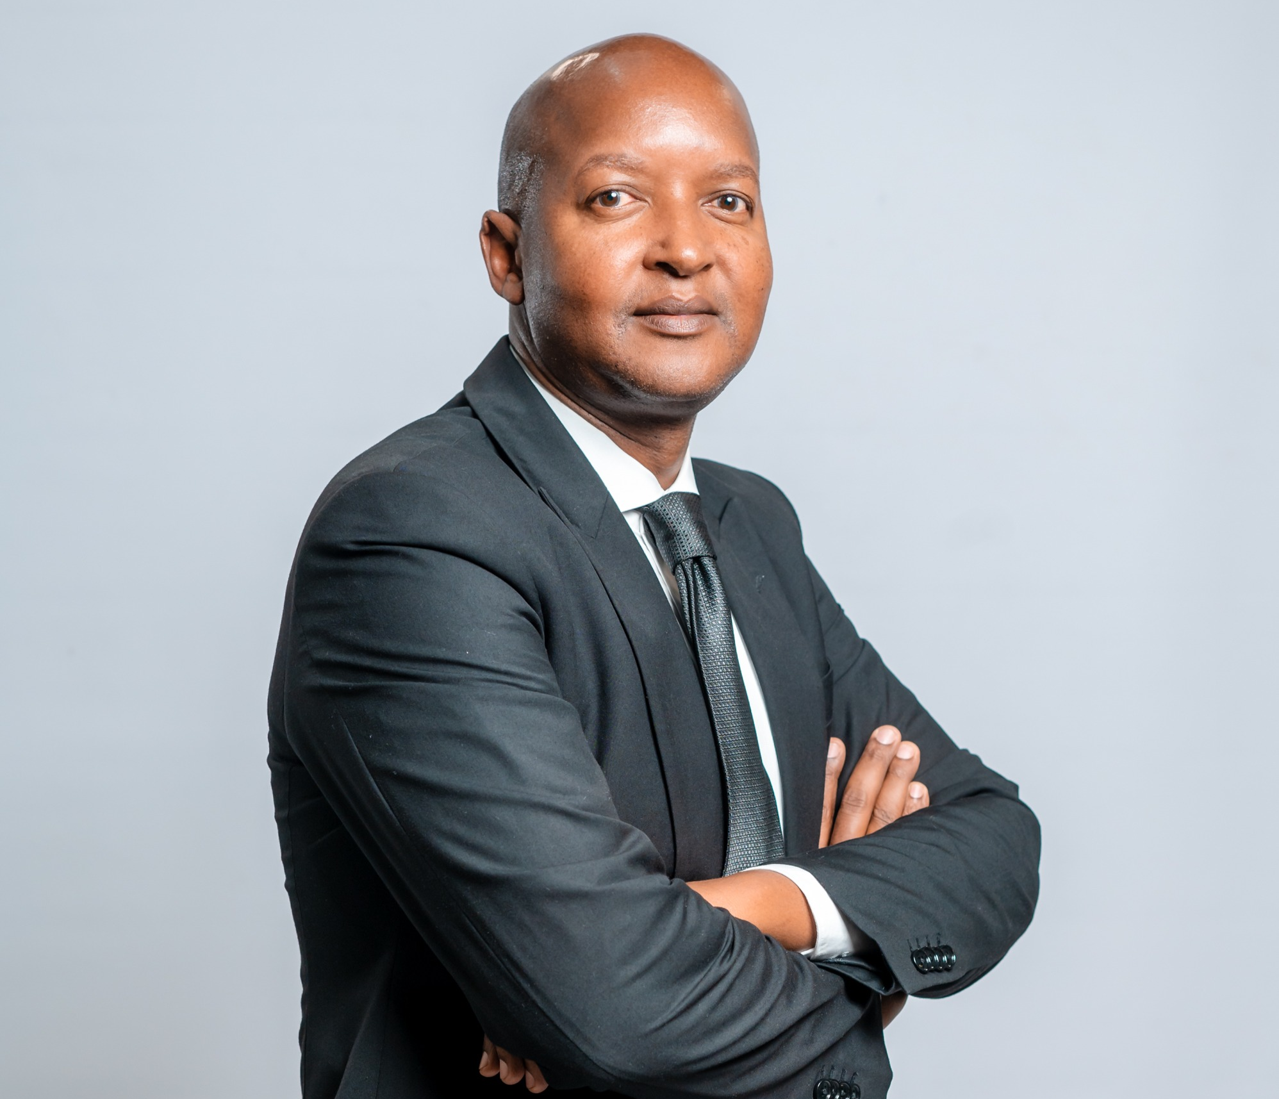
Siyabulela Tsengiwe
Governance and Fiduciary Responsibilities Aimed at Maintaining Medical Aid Sustainability

Slide 3
Role of the Board of Trustees
The Board of Trustees as the governing body is responsible and accountable for the performance and affairs of the Scheme
In exercising its oversight function, it must provide ethical and effective leadership which is critical to the proper functioning of Medical Schemes
The Trustees elected by Members and appointed by the Employer are representatives of the Scheme’s members
Legally responsible for the Scheme’s management and strategic direction on behalf of the members
The Board of Trustees exist to protect the interests of members whose moneys (contributions) and employer subsidy make up the revenue of the Scheme

Slide 4

Constitution of the Republic of South Africa Act 108 of 1996
Other Relevant Legislation and Regulations
Scheme Rules; Board Charter & Scheme Policies
King IV Code of Governance Principles for South Africa
Medical Schemes Act 131 of 1998
Protection of Personal Information Act 4 of 2013
Promotion of Access to Information Act 2 of 2000
National Health Insurance Act 20 of 2023
Legal Framework, Policy & Guidelines

Slide 5
Strategy and Execution
The BOT is responsible for providing strategic direction. Yes, management plays an important role in the formulation of the strategy, however approval resides with the Board. The BOT also approves Annual Business Plans that give effect to the strategy.
Developments in the health sector, globally and domestically dictate that Trustees become more strategic than ever before in the governance of Medical Schemes
The execution of the approved strategy is the responsibility of Management. The Board monitors and evaluate the execution of the strategy to ensure the achievement of the strategic objectives

Slide 6
Principal Officers
Probably, the No 1 task of the Board is the appointment of a Principal Officer,
fit and proper
The principal Officer operates in terms of authority delegated by the Board. However, overall accountability on the delegated authority vests with the BOT
Micro-management? Creating an enabling environment for the Principal Officer to manage the organization – simultaneously hold the PO accountable
Trustees must resist the temptation to get involved on operational matters and stay focused on their oversight function, all in the name of good governance

Slide 7
Decision-making
Decision-making on matters of policy and strategy must be well-informed, positive and constructive
Trustees ought to bring their independent and critical minds to all the issues before the Board, which helps to enrich decisions of the governing body - in best the interest of members
Decisions of the Board must be able to pass the test of rationality and procedural fairness
The true test of leadership is not during the nicest of times but the most difficult times
One of the hard decisions that the GEMS BOT had to make last year was in respect of contribution increases for this year. After a careful consideration of all the relevant factors the Board had to find a balance between affordability and financial sustainability.

Slide 8
Financial Sustainability
SOLVENCY
BOARD OVERSIGHT RESPONSIBILITIES
A measure of the scheme’s ability to meet its long-term obligations to members.
Compliance with the 25% statutory solvency requirement.
Sustainable contributions and benefit design to protect solvency.
Effective investment strategy to grow reserves and cushion underwriting deficit.
Risk management (claims, FWA, adverse demographic shifts)
WHAT SOLVENCY MEANS FOR MEDICAL SCHEMES
A higher solvency ratio indicates stronger financial resilience and the ability to absorb unexpected claims.
Low solvency threatens sustainability, member protection, and regulatory compliance.
Solvency is influenced by claims experience, contribution income, investment performance, and non-healthcare costs management.

Slide 9
Stakeholder Inclusive Approach
Stakeholders are Parties who have a stake in the business of a Medical Scheme to the extent that Scheme decisions affect them, therefore their interests must be taken into account. This is critical for the overall financial health and sustainability of the scheme.
Although the Scheme must put first what is in the interest of members (owners) that does not mean disregarding the interests of its stakeholders in decision-making.
GEMS Key Stakeholders : Minister of PSA; PSCBC;UNIONS; SPNs & Healthcare Providers
Creating value for all stakeholders

Slide 10
THANK YOU
We look forward to hosting you next year!

