Slide 2
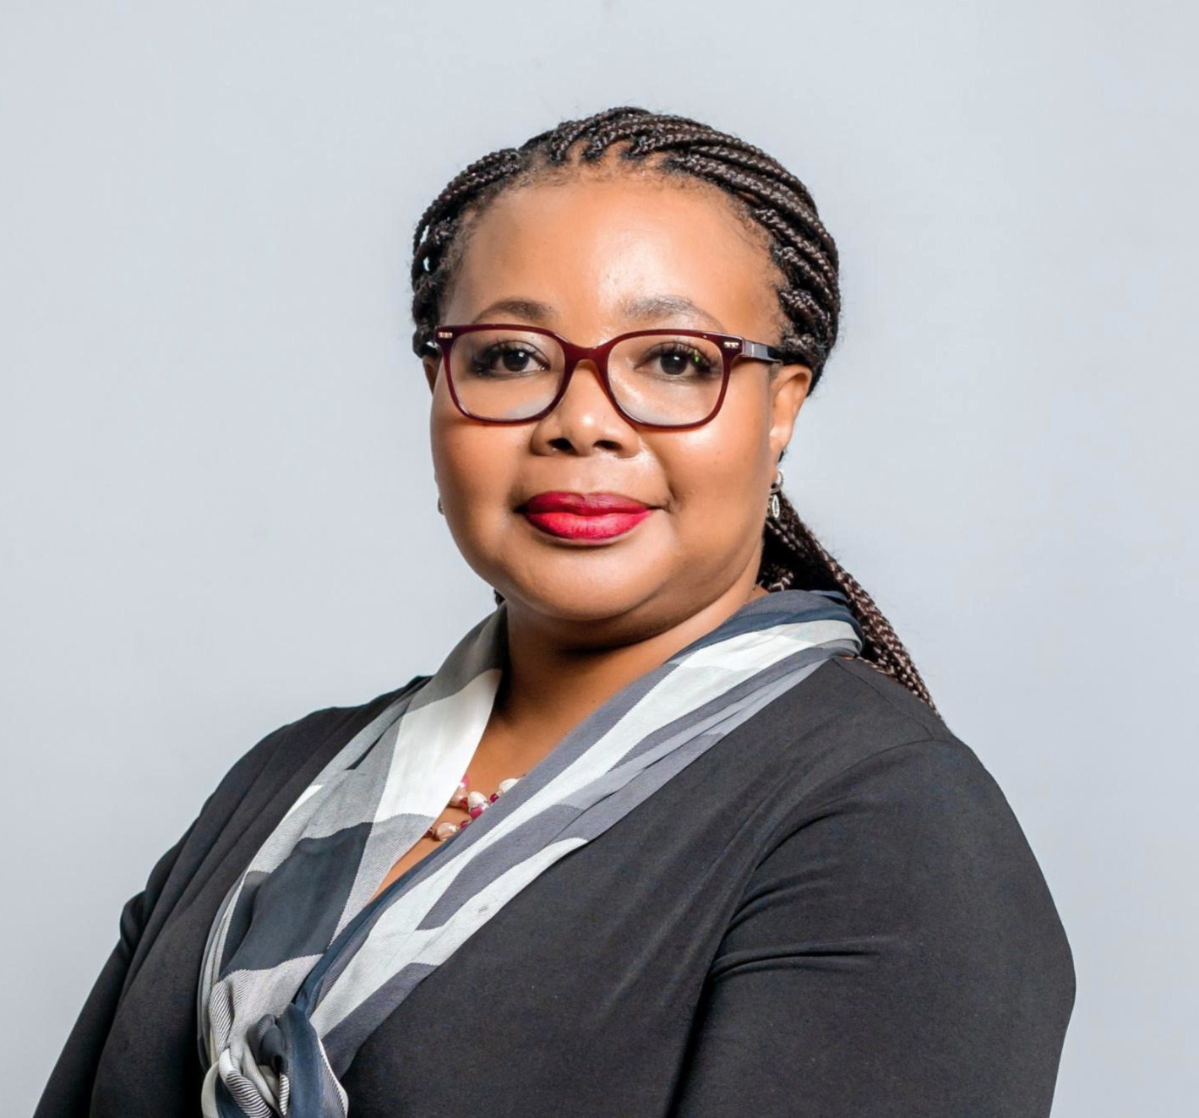
Dr Vuyo Gqola
Chief Operations Officer, GEMS
Putting Members First:
Beyond One-Size-Fits-All Benefits

Slide 3






OUTLINE
Background
Personalised Healthcare
Overarching Benefit Entitlements
Condition Specific Entitlements
Patient Specific Entitlements
The Way Forward

Slide 4

Background

Slide 5

BACKGROUND
GEMS was established in 2005 to ensure the provision of quality healthcare services to public servants and their dependents that are cost-efficient, effective, and equitable.
GEMS is the largest closed medical scheme in South Africa with over 2.4 million beneficiaries.
This translates to more than 1 in every 4 medical scheme beneficiaries.

Slide 6

BACKGROUND
The benefit structures provided by GEMS need to be sufficiently standardised to ensure fairness, administrative efficiency, regulatory compliance and consumer understanding.
Simultaneously, GEMS needs to provide benefits which are sufficiently tailored to cater to the unique needs of all 2.4 million beneficiaries.

Slide 7
Personalised Healthcare

Slide 8

Personalised Healthcare
Imagine a shoe store that only sells one size shoe - size 6
If you happen to wear size 6, that is great. If you wear a size 4 or a size 8, you are either cramming your foot painfully into something too small or tripping over something too big.
Either way, you are uncomfortable, and you are not getting what you need to walk well.

Slide 9

Personalised Healthcare
Health insurance works the same way:
People’s medical needs vary as much as their shoe sizes. A healthy 25-year-old marathon runner does not need the same benefits as an 80-year-old managing chronic conditions.
A one-size-fits-all solution risks giving some people far more than they are likely need (making them overpay) whilst leaving others without the coverage they desperately need

Slide 10
Personalised Healthcare
Patient-specific entitlements
Condition-specific entitlements
Overarching benefit entitlements
3
Three levels of personalisation
2
1

Slide 11

Personalised Healthcare
Patient-specific entitlements
Condition-specific entitlements
Overarching benefit entitlements
3
2
1

Slide 12



OVERARCHING BENEFIT ENTITLEMENTS
Personalisation: benefit entitlements
Multiple options offering varying benefit entitlements at different price levels
A basic benefit option with an emphasis on primary and preventative care
Unlimited GP consultations and basic pathology and radiology
Hospital network as well as mandatory coordination of care
A basic benefit option with an emphasis on primary and preventative care
Unlimited GP consultations and basic pathology and radiology
Underpinned by a personal medical savings account and a primary extender benefit

Slide 13



OVERARCHING BENEFIT ENTITLEMENTS
Personalisation: benefit entitlements
Multiple options offering varying benefit entitlements at different price levels
Comprehensive benefit entitlements beyond that which would be associated with a basic benefit option
Hospital network as well as mandatory coordination of care
Comprehensive benefit entitlements beyond that which would be associated with a basic benefit option
Exceptionally comprehensive benefit entitlements

Slide 14
OVERARCHING BENEFIT ENTITLEMENTS
Personalisation: benefit entitlements
Older beneficiaries with chronic conditions are more likely to opt for more comprehensive options

Slide 15
OVERARCHING BENEFIT ENTITLEMENTS
Personalisation: benefit entitlements
Beneficiaries who are more likely to require in-hospital care opt for more comprehensive options whilst those who are more likely to require primary care opt for basic benefit options

Slide 16

Personalised Healthcare
Patient-specific entitlements
Condition-specific entitlements
Overarching benefit entitlements
3
2
1

Slide 17



CONDITION SPECIFIC ENTITLEMENTS
Personalisation:
condition specific
Extraordinary benefit entitlements are linked to specific conditions taking cognisance of member needs
Disease management programs
Maternity program
Structured value based care initiatives

Slide 18
CONDITION SPECIFIC ENTITLEMENTS
Discipline | Consultations per year over and above standard benefits
General practitioners | 2
Ophthalmologists | 1
Dieticians | 1
Nurses | 1
Podiatrists | 1
Pathology tests over and above standard benefits
Hba1C | Cholesterol
Creatinine | Glucose
Potassiumh | Sodium
Urea | Micro albumin
Procedures over and above standard benefits
ECG | Tonometry
Fundus examination
Fundus photography
Retinal threshold
Disease management program, diabetes example

Slide 19




Condition Specific Entitlements
Medication
Metformin | Saxenda
Consultative services
Pathology Tests
Fasting lipogram | GGT
TSH | FT4
Fasting insulin | HbA1C
Cortisol | Vitamin D
Testosterone | LG/FSH
General practitioners
Biokineticist
Psychologist
Dietician
Disease management program, weight management pilot example

Slide 20
CONDITION SPECIFIC ENTITLEMENTS
Patients with terminal cancer have access to a multidisciplinary care team which delivers comprehensive palliative care services.
The team comprises of general practitioners, oncologists, nurses and social workers to deliver coordinated care in accordance with best-practice clinical guidelines.
Access to the program is funded over and above standard benefit entitlements in recognition of the extraordinary needs of terminal cancer patients.
Structured value-based care initiatives, palliative care

Slide 21
CONDITION SPECIFIC ENTITLEMENTS
% of deaths at home
Non beneficial care – chemo
Non beneficial care – surgery
Total costs of care
Patient/
family experience
Payments are linked to the value delivered by the program. Improved process and surrogate outcome measures translate into higher fees.
Structured value-based care initiatives, palliative care

Slide 22
CONDITION SPECIFIC ENTITLEMENTS
66%
Structured value-based care initiatives, palliative care

Slide 23

Personalised Healthcare
Patient-specific entitlements
Condition specific entitlements
Overarching benefit entitlements
3
2
1

Slide 24


PATIENT SPECIFIC ENTITLEMENTS
Personalisation:
patient specific
High risk member management programs to help beneficiaries to navigate their available benefits and the healthcare system at large
Population medicine initiatives whereby beneficiaries receive unlimited primary care at the discretion of a multidisciplinary team of healthcare professionals

Slide 25
PATIENT SPECIFIC ENTITLEMENTS
Patients (in certain regions) have access to a multidisciplinary care team which delivers comprehensive primary care services.
The team comprises of general practitioners, physiotherapists, social workers, OTs and psychologists to deliver highly coordinated care.
The team receives risk-based capitation fees which are linked to both healthcare outcomes as well as downstream cost savings.
Population medicine initiative

Slide 26

PATIENT SPECIFIC ENTITLEMENTS
POPULATION MEDICINE
Reductions in the number of preventable admissions: asthma (0.5%), HIV (8.2%), dehydration (18.7%) and UTIs (12.8%)
A 1.0% reduction in overall admission rate for beneficiaries with chronic conditions

Slide 27
The Way Forward

Slide 28

Collaboration with members and healthcare providers is key. There remain many possibilities to explore and the future is bright.
Striking a balance between benefits which cater to the needs of the collective and benefits which cater to the needs of the individual requires constant refinement and calibration. Personalisation occurs at multiple different levels

Slide 29
THANK YOU
We look forward to hosting you next year!

