Slide 2

Dr Gregory Pratt
Mitigating FWA Impact to Support Scheme Sustainability

Slide 3
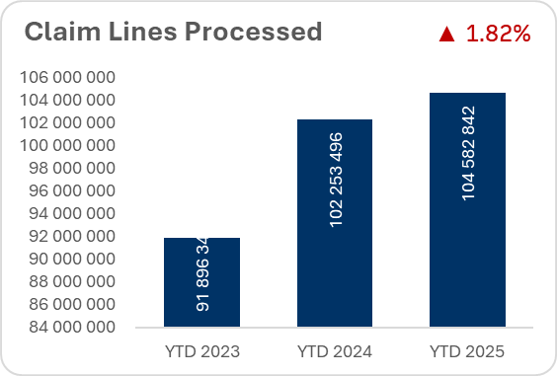
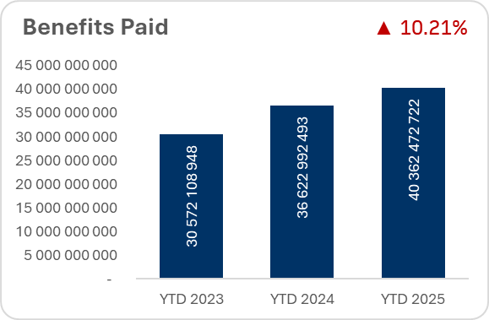
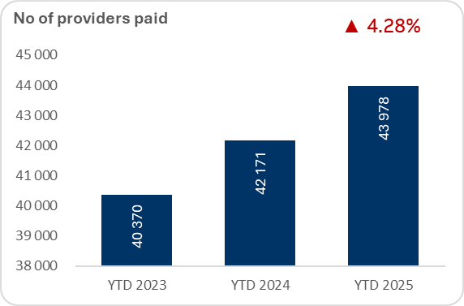

GEMS volume: JAN – JULY 2023-25
The GEMS ‘Haystack’ - Full year 2025: 180 million claim lines - over R65 BILLION being paid out for healthcare services - over 43 000 practitioners, facilities, pharmacies and other entities.

Slide 4

SYSTEM CONTROLS
First-line of defense:
  Beneficiary / eligibility checks to access benefits
  Benefit option limits and conditions
  1000s of system billing rules:
    To Detect obvious billing errors
    To Reject anomalous codes / tariff combinations / amounts charged
    To Refer specific claims for clinical review / manual checks
  FICA checks on new providers
EG. Gynaecologist accounts person loaded the Rand amount in the ‘multiplier’ field – billed over R2.3m for a single short theatre event

Slide 5

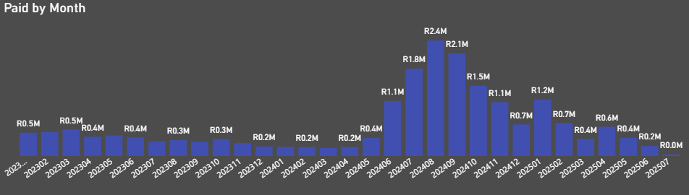
detection / analytics
GP benchmarking: rapid escalation from R250k/month to R2.4m in a single month – triggered an audit:
  over-servicing and abuse on ultrasounds, >60% of consults billed with ultrasound when peers under 15%
  Significant change in behaviour after engagement
  Recovery underway
FWA HOTLINE: Highest volume of leads for investigations – members have first-hand information on possible fraud

Slide 6
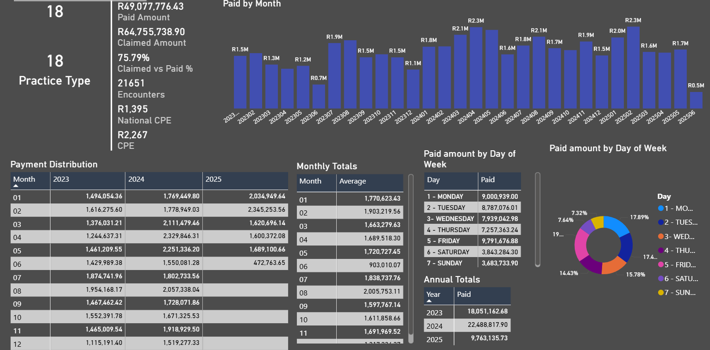
Analytical tools
Ability to aggregate claims data over years to evaluate billing patterns and to compare with peers in the same discipline – visual dashboards and tables that can be filtered in real time allow efficient analysis and decision making.

Slide 7

Pre-payment analyses
>R2.5 Billion paid in a claims run
>200 new practices claiming – no history
Last-minute claims submissions – time sensitive
Discipline thresholds and Velocity reports used to identify outliers
Link analyses to known fraudulent practitioners
Compare payment history to current claims batch
Review in-depth practice profiles for outliers identified
Decision making for suspension of claims, where risk deemed too high to pay ‘in good faith’
Engage practice in following week for validations and supporting documents

Slide 8

RETROSPECTIVE AUDITS
Data aggregated over 2 – 3 years, to get holistic view
Review entire coding profile for appropriateness
Clinical review and society engagements
Practice context and documentary evidence as necessary
Confirmation of irregularities and possible over-payments due to:
  Over-charging / unacceptable code combinations / over-servicing / billing errors / invalid claims
Virtual / In-person meetings to get further clarity / to discuss concerns / to resolve issues / determine way forward
Payment arrangements if needed
SYNDICATES / COLLUSION: Touts enticing members with cash-back schemes / sharing of member data between practices / members getting fees for recruiting others / member collusion prevents whistleblowing / move on to new practice numbers as Scheme blocks others

Slide 9

Fwa Prevention
CRUCIAL TO PREVENT FUTURE LOSSES:
Benefit design amendments
Stricter underwriting implemented
Broader care authorization processes
Expanded and enhanced system billing rules
Increased analytical capability:
  Machine learning / AI Technology
  Better sensitivity and greater FWA detection volumes
More investigative resources
Collaboration within industry – including regulatory bodies
Pursue tougher sanctions where fraud exposed – on both providers and members
SAPS reporting for confirmed fraud
Member awareness activities
Important to retain access for members to necessary care whilst curtailing opportunity and risk for FWA!

Slide 10

conclusion
COLLABORATION with all stakeholders to curb the incidence and risk of FWA is essential
Every instance of FWA that goes undetected, is a drain on Scheme resources which member contribution increases will need to cover.
A complex healthcare environment + huge claims volumes + tight deadlines to pay = opportunity for FWA
Every effort must be made to address FWA for the benefit of Members and the sustainability of GEMS

Slide 11
THANK YOU
We look forward to hosting you next year!

