Slide 2



High performing health systems
Hospitals
Funders
Patients
Healthcare Professionals
Expertly diagnose and treat, driving care excellence
Deliver cutting edge facilities and services for optimal health outcomes
Enable access to care through seamless financial support, measurement focused on value
Active, empowered and represented
Notes:
In an ideal world

Slide 3
Measuring value requires measuring quality
Traditionally we’ve focussed on proxy process measures such as screening rates, compliance etc, and hard outcomes measures such as mortality rates, complication rates, redo rates, etc.
Value = fn(Cost ; Quality)
Cost data is single currency and readily available and easy to measure. Analysis techniques well developed, established and accepted.
Quality is multi dimensional; data is not readily available. Analysis techniques are developing and reporting is still gaining trust.
But until recently, we never really asked patients how they felt about the care they received.
The best systems combine patient feedback with hospital and clinical data to provide a complete picture of care quality. PREMs and PROMs are vital for aligning services with patient needs.
Have to collect new data.

Slide 4



Voice of the patient
Voice of the Patient is a patient engagement platform that collects patient reports experience and patient reported outcomes metrics using scientifically validated question sets, and ongoing operational improvement techniques.
Over 1.5 million surveys distributed in Australia & South Africa since inception with > 35% response rates.

Slide 5

the patients perspective
Patient Reported Experience
PREMs focus on how patients feel about the care they receive, rather than just the results of treatment
Patient Reported Outcomes
PROMs assess the actual results of healthcare from the patient’s perspective. They focus on health outcomes that directly impact the patient’s daily life, rather than just medical results.
Communication
Pain
Management
Fatigue
Ease of Accessing Care
Emotional
Wellbeing
Mobility
Respect and Empathy
Notes:
to create a patient centered value approach we need the patient perspective

Slide 6












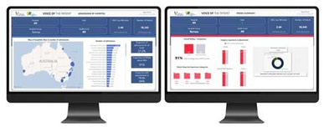





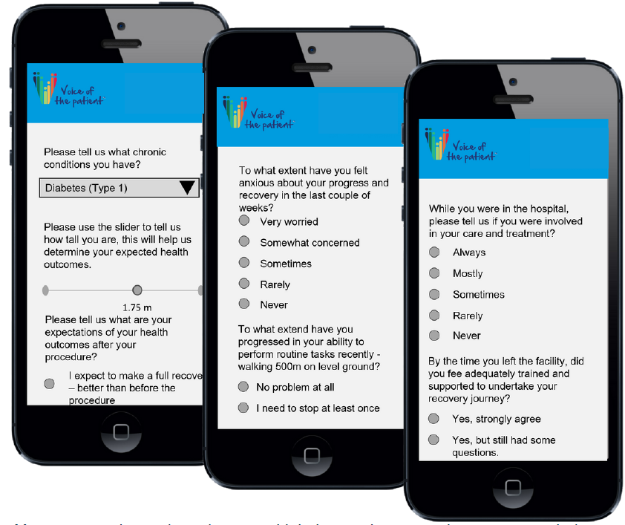


Interaction Pathway
6
7
Active Measurement
1
2
3
Response Window
Trigger event (e.g. doctor visit)
Condition rules applied
Invite patient to participate
(email and/or SMS)
4
5
Results captured
Results, Comparison and Benchmarking

Slide 7
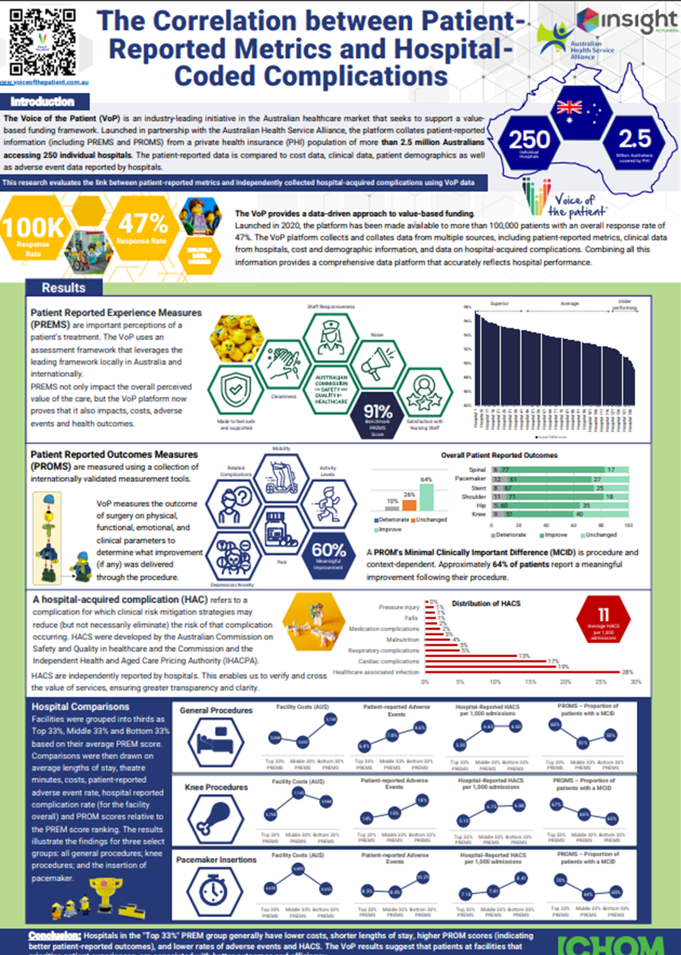


Case study 1: The impact of positive PREMs
Hospitals which score in the top 33% of PREMs:
Lower overall costs
Shorter LOS
Higher PROMs scores
Lower adverse event rates
Lower HAIs
Identify areas of poor PREMs
Focused interventions to improve patient experience toward creating improved shared value
Notes:
AUS

Slide 8
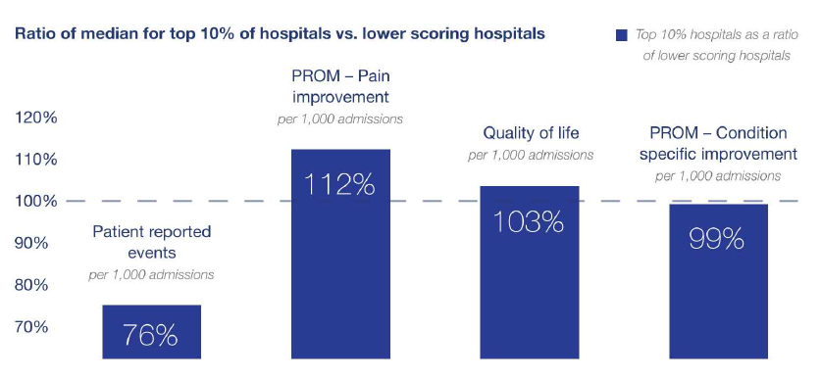
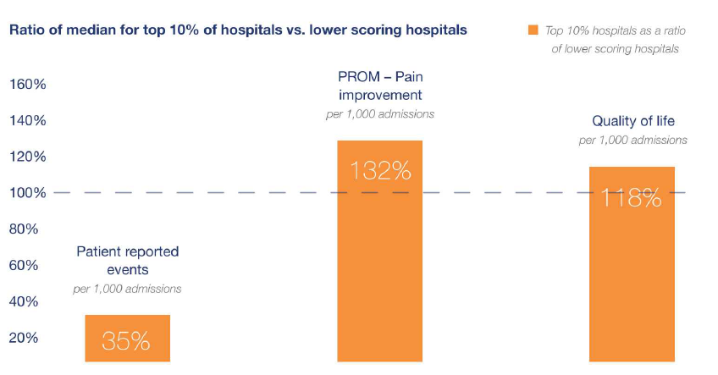
Case study 2: Relationship between PREMs and PROMs
Hip replacement
Top 10% high scoring PREMs hospitals:
Lower patient reported events
Greater improvement in pain
Higher reported QoL
Hernia repairs
Top 10% high scoring PREMs hospitals:
Lower patient reported events
Greater improvement in pain
Higher reported QoL
https://ahsa.au/wp-content/uploads/2025/04/VoP-Why-Measurement-Matters-Report.pdf
Notes:
AUS

Slide 9
Case study 3: shining a light on a maternity programme
At 12 weeks post partum, mothers reported a reduction in their QoL and the ability to fulfil social roles and activities
Higher levels of fatigue were also reported during this period
Traditional maternity programmes only offer support up to 6 weeks post partum
Review of maternity benefit to support mothers for a longer period, as well as linkage with mental health programmes
Excellent/very good
Fair/ Poor
Excellent/very good
Fair/ Poor
Notes:
Prematernity survey: 14 days prior to admission, up to 10 days post discharge. Post survey @12 weeks post discharge

Slide 10
applications
Measuring what matters to patients, allowing patients to feel heard, engaging patients on their care journey outside of claims, all have enormous value in their own right.
Collecting the right data timeously, allows provider engagement and discussions on improvement strategies.
Voice of the Patient information can be collated into provider contracting with providers to make progress towards value-based care contracts.

