Slide 2
How AI Can Improve Clinical Outcomes
Case Study 1
Luis da Silva - Healthbridge CEO

Slide 3
Your future doctor is using ChatGPT to pass med school…
so it's probably a good time to start eating healthy…

Slide 4


Slide 5
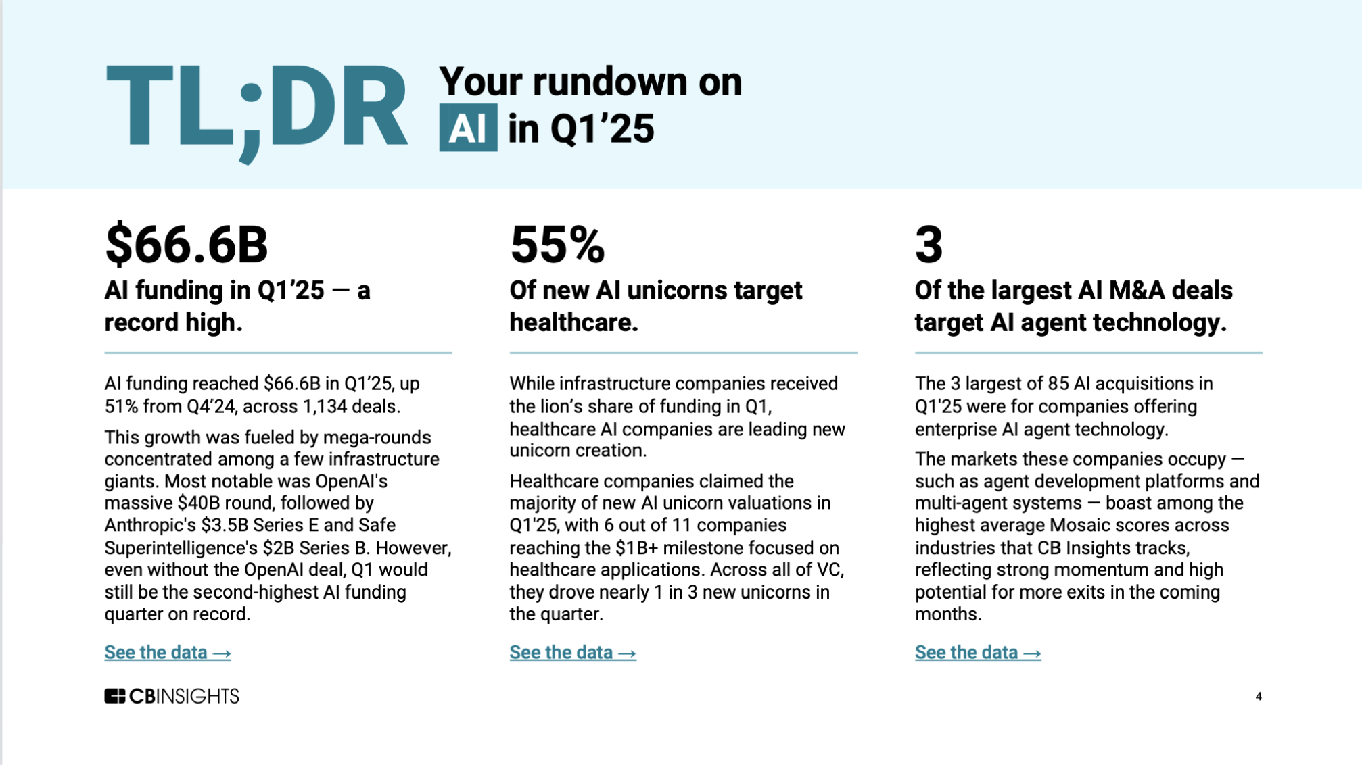

Slide 6
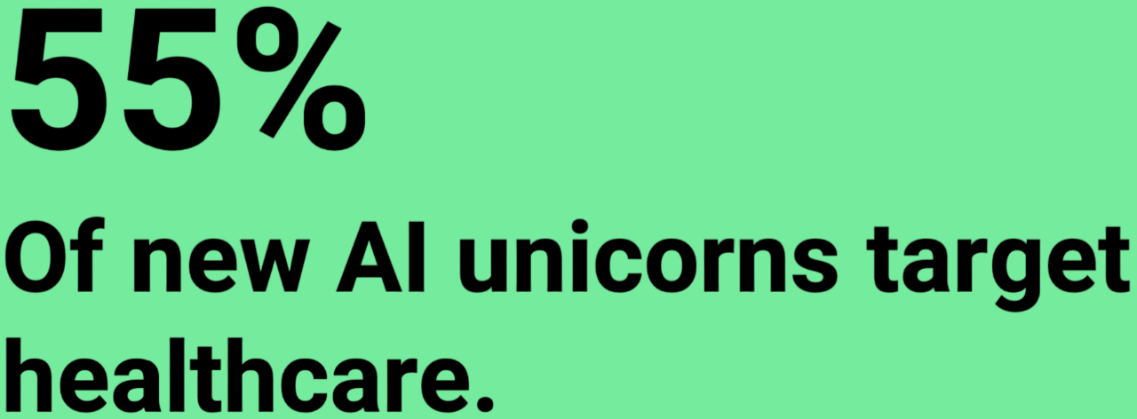
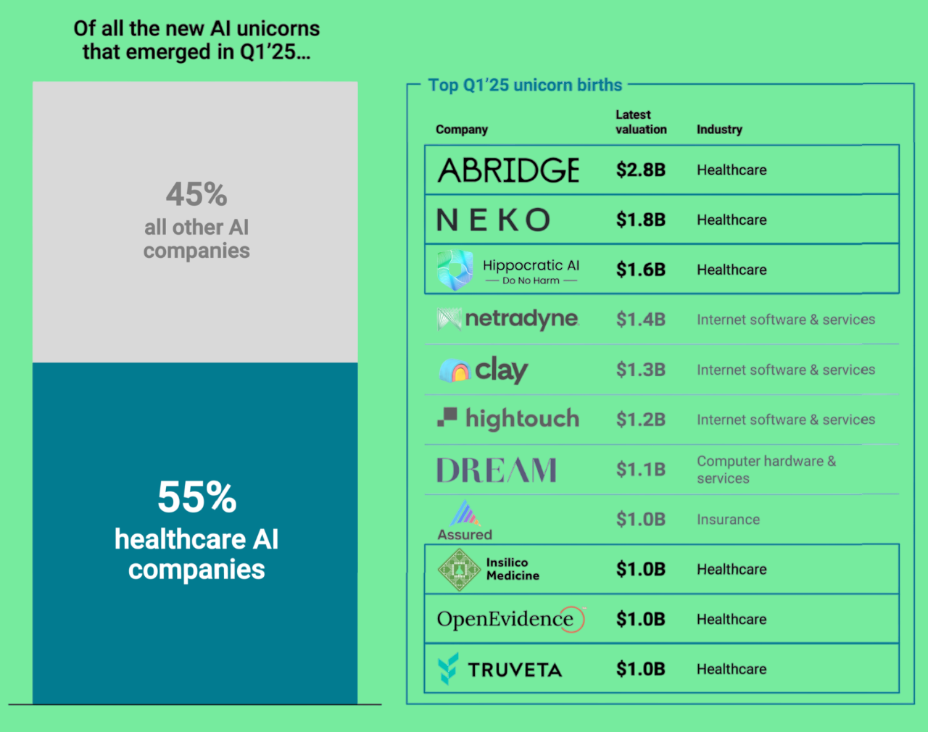
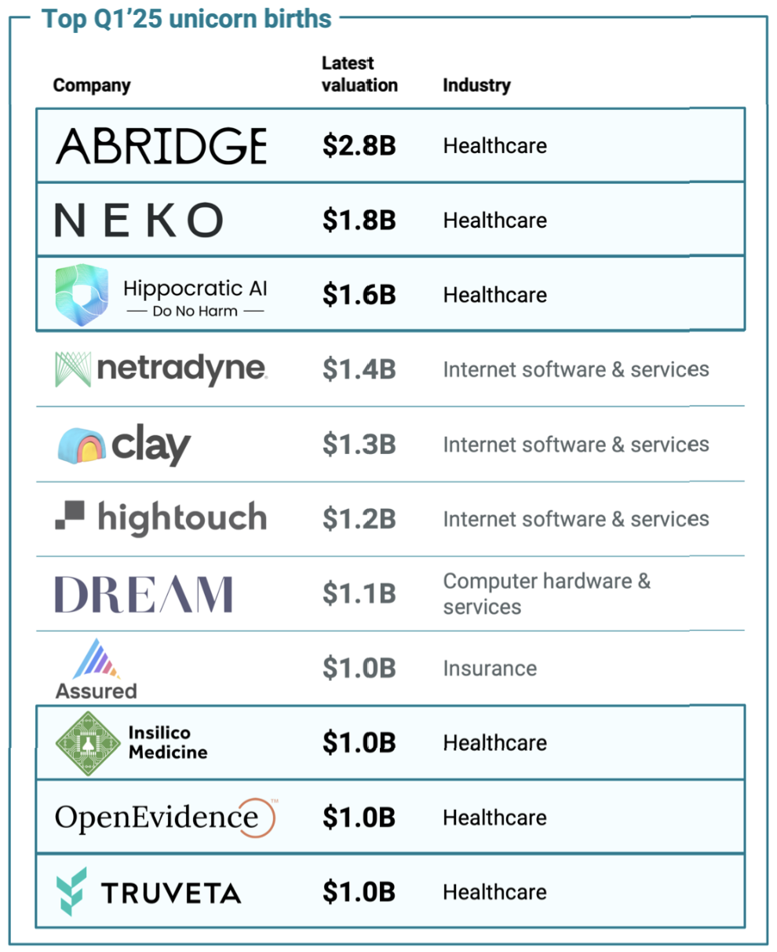

Slide 7
How is AI improving
clinical outcomes
and reducing costs
today?

Slide 8
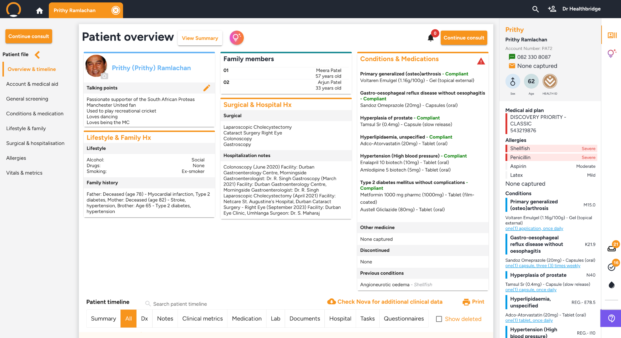
How is AI improving clinical outcomes, today
Predictive
Preventative
Personalised
Participatory
Precision

Slide 9
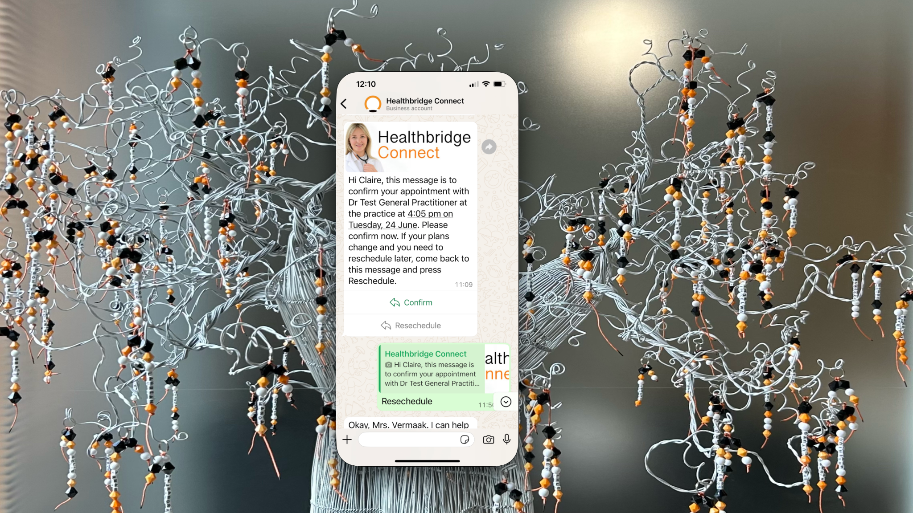
WhatsApp Patient Booking
Notes:
I’m going to first start with WhatsApp on my mobile which is mirrored here onto my laptop, apologies for the noisy wallpower.
Here a communication and engagement channel for doctors has been created by orchestrating Agentic AI. These AI agents range from admin agents, to clinical agents and soon billing agents. Each of these agents are trained in their specific field of expertise and interact with the platform to provide the patient with information backed by the relevant context.
So here we can see that Claire’s appointment was set up and confirmed for today, much like the Safair booking experience. We’ll be coming back to this patient / doctor channel later in the session.

Slide 10
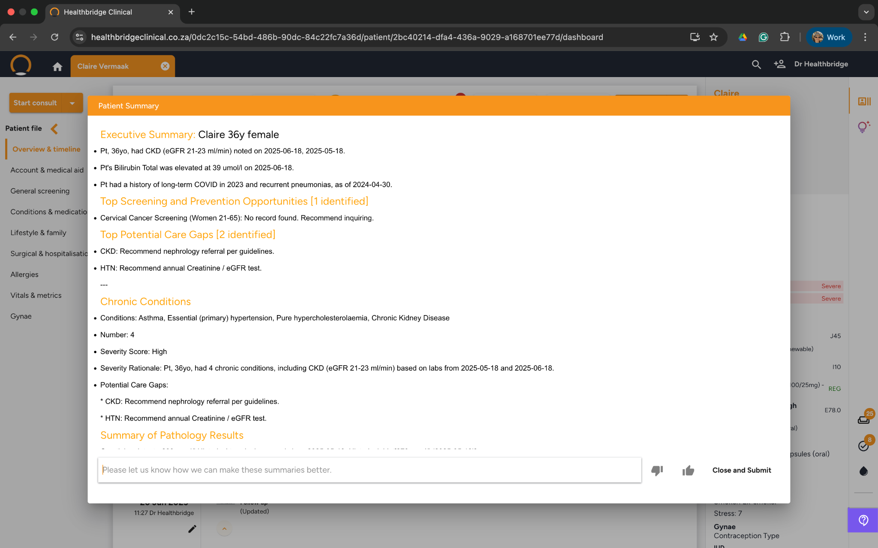
View Summary
Notes:
Let’s now turn to the EHR. You will see that on the calendar Claire Vermark is next up. Let's open her file.
On this page you will see some general data on Claire, her time below and some key information that needs to be kept top of mind will treating Claire, like allergies etc.
The first thing a doctor can now do is call for Claire’s Summary to get a holistic but summarised view of Claire before treating her.
Here AI combs through Claire’s demographics, her timeline of visits, medicines prescribed, blood tests done and anything else relevant to give the doctor a snapshot of the patient before starting the consult. Importantly, it also highlights screening opportunities and care gaps for Claire, especially if there are chronic conditions .
“Ok, I now know about Claire, I’m ready to treat her!”

Slide 11
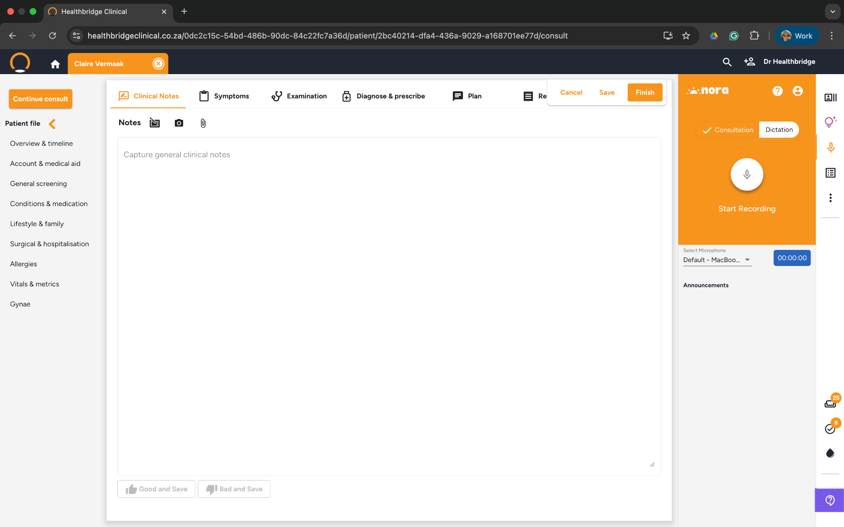
Nora AI option
Notes:
Here medically trained LLMs listen into the conversation between patient and doctor allowing the doctor to be completely present and engaged with the patient, not worrying about writing or typing any clinical notes. At the end of the consultation medical grade notes are generated, presented to the doctor for final review and then committed to the patient's record.
In the interests of time, I'm not going to go through a full consult right now but rather turn to a previous real world “speech to clinical notes” recording. You’re welcome to go to our our pod at the exhibition area and try it out however.

Slide 12
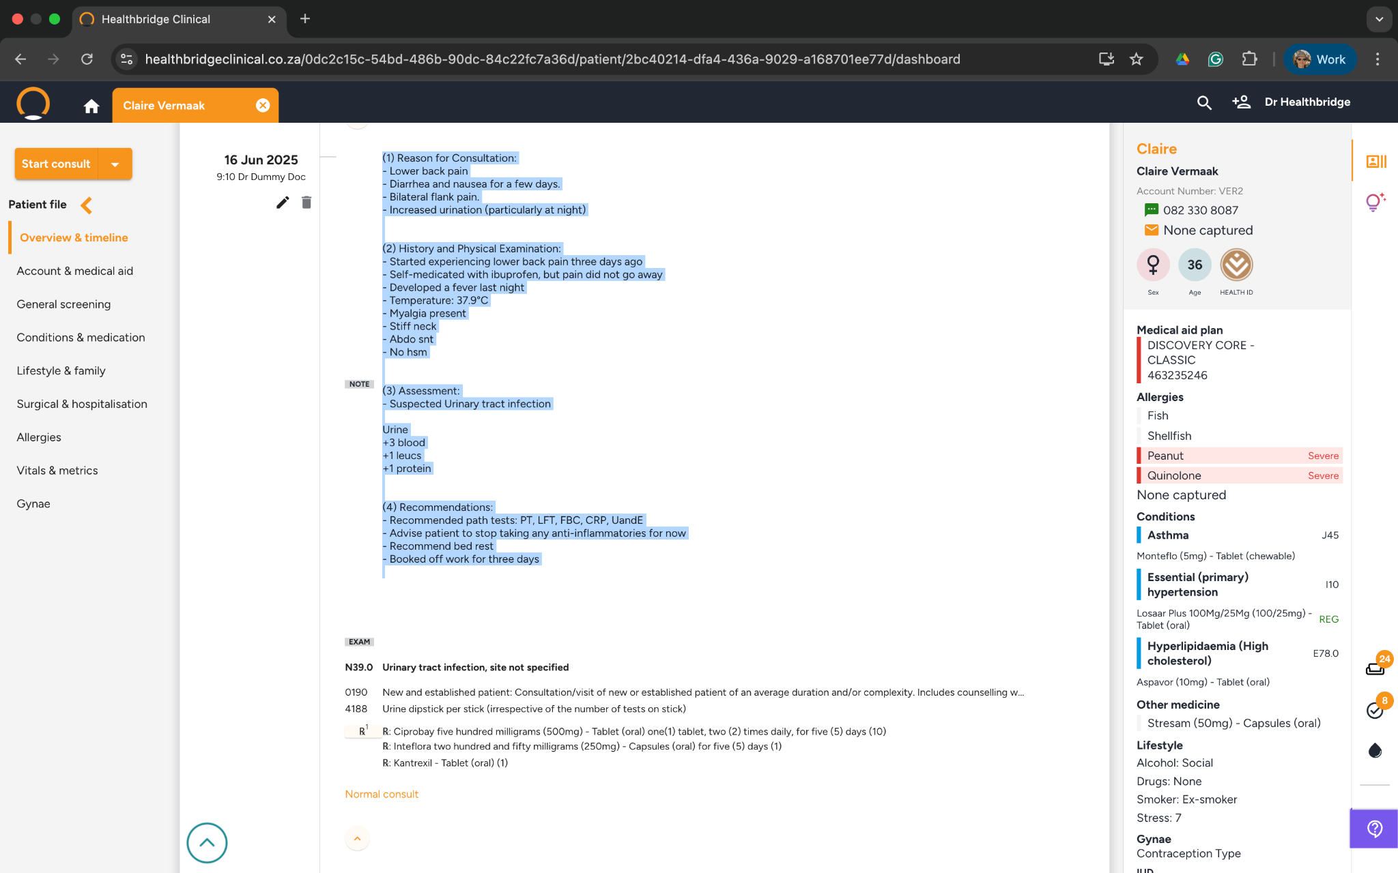
Ambient AI note taking
Notes:
So, here you have the medical transcription of a previous real world consult, highlighting the reason for the consultation, the result of the physical examination, the assessment and recommendation by the doctor. This was all done without a pen or keyboard, just AI’s ambient listening.

Slide 13
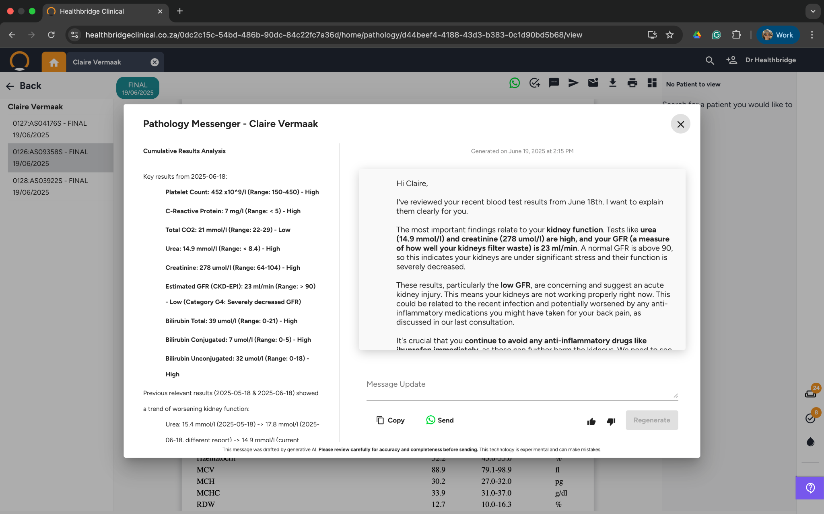
Path Interpreter/Messenger
Notes:
A little while later, typically the day after, the blood results come back. Again this is another point tension for both doctor and patient.
For the doctor, how and when do I remember to look out for all my patient's blood work? How do I communicate this effectively?
And for the patient, has my blood tests come back? What are the results? Should I call the doctor or will the doctor call me. And as a doctor, how do I quickly interpret the results and efficiently communicate to the patient?
So here on the left we see a summary of the blood results powered by AI. A summary and rationale is provided to the doctor, and this is trained with great clinical depth and takes into consideration previous results and other qualitative pieces of information. And on the right a message to be sent to the patient is proposed. Let's take a read.
The doctor can fine tune the message before sending to the patient, again through WhatsApp channel of the practice.

Slide 14
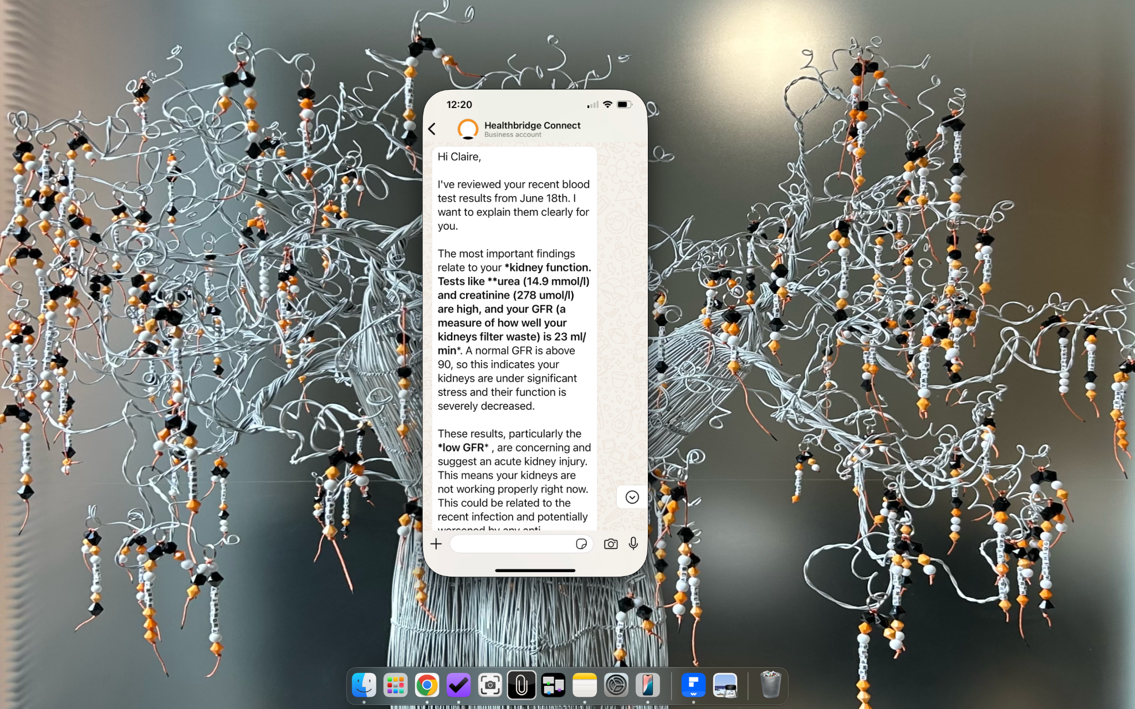
WhatsApp Patient Path Summary
Notes:
Here we can see the message coming through, moments later.

Slide 15
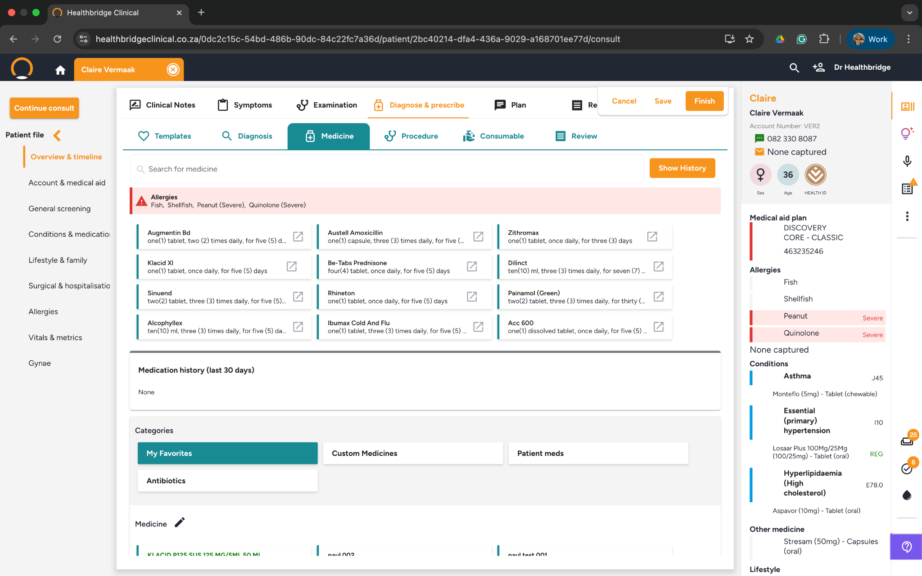
Suggestive Meds
Notes:
Right, at this point I‘m going to start a new appointment for Claire and quickly diagnose her with bronchitis for the purposes of this part of the demo.
AI leverages the diagnosis and suggests the medication options for this condition, taking a number of factors into consideration.
So, for bronchitis; let's agree to prescribe Augmentin the antibiotic, but I’m not happy with the steroid it suggested, so let's look for other options.

Slide 16
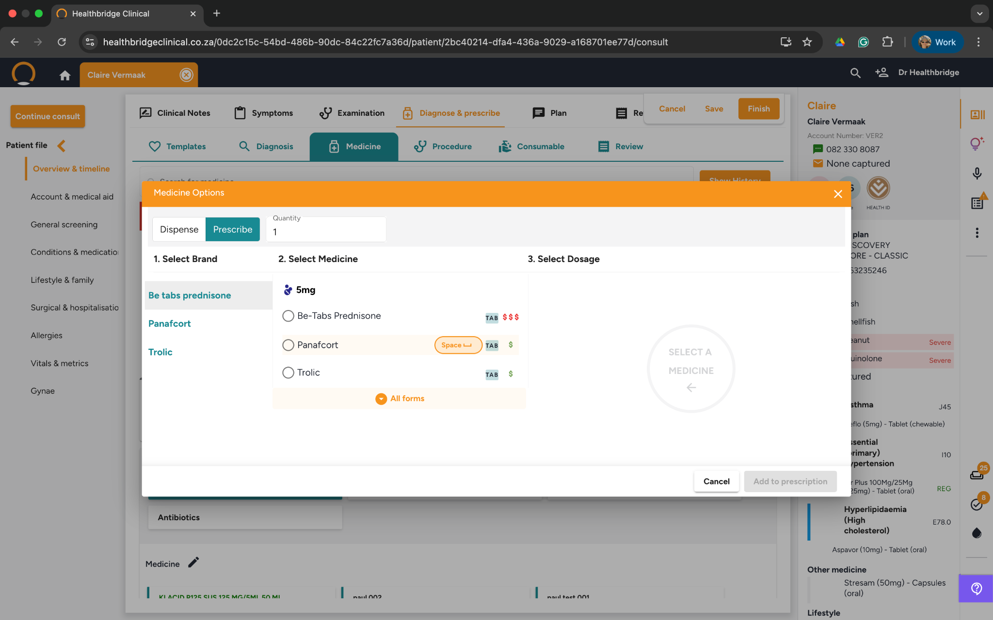
SmartMeds
Notes:
Immediately AI, understanding the ATC class of the steroid, proposes other options, which I can easily select, together with AI’s suggested dosage and treatment regime.

Slide 17
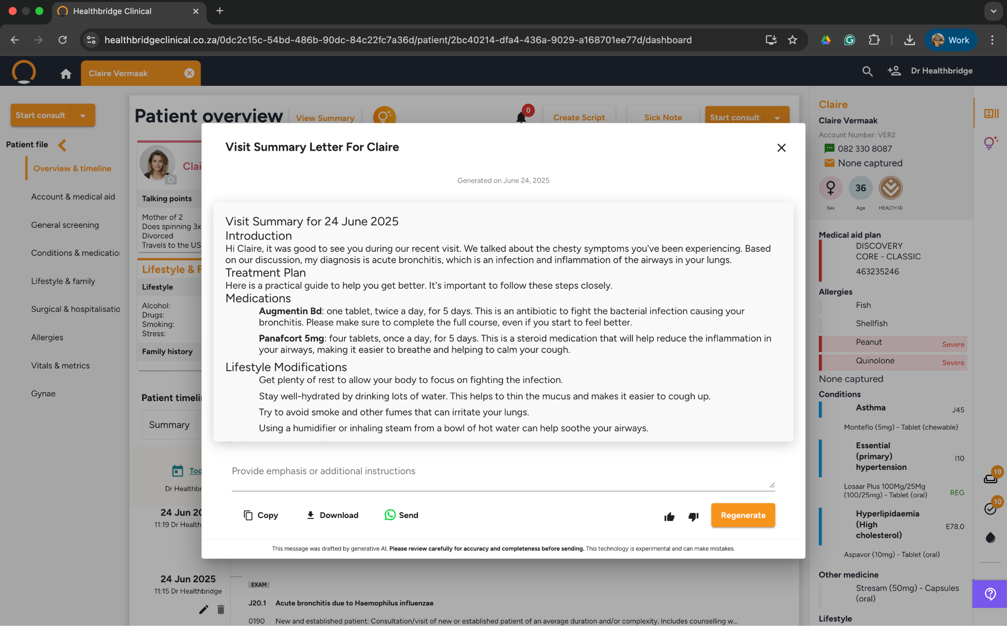
Patient Summary
Notes:
To close off the consult AI addresses a real tension between patient and doctor. The healthcare professional needs to move on to the next patient. But the current patient might be left a bit a bit overwhelmed and confused about the diagnosis and next steps.
Here AI generates a “layman’s summary” of the findings and next steps to be sent to the patient to read and process after the consult in understandable language. This in turn can be sent via the doctor’s WhatsApp patient engagement channel.

Slide 18
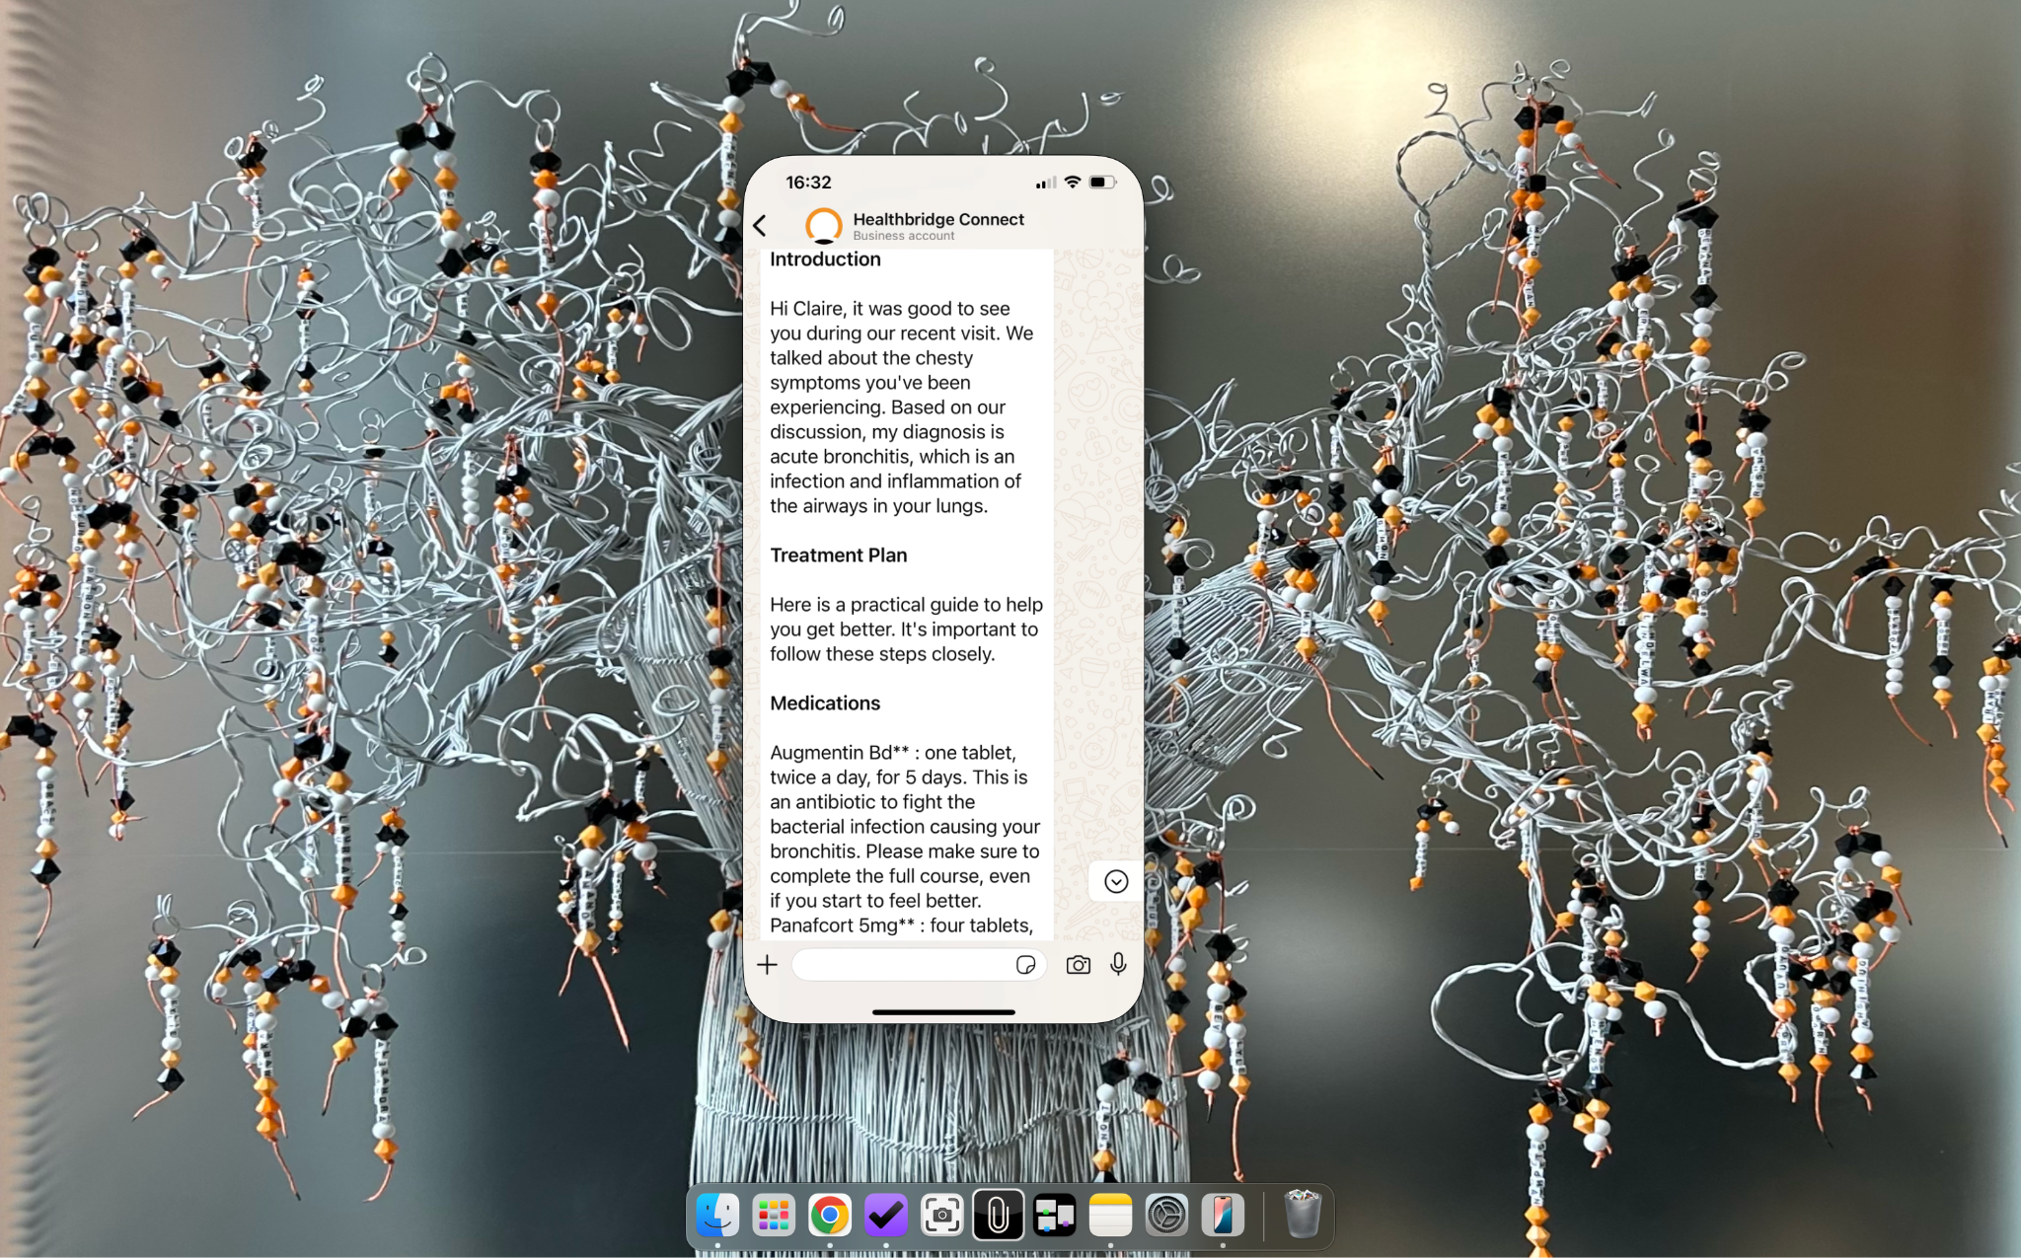
WhatsApp Patient Summary
Notes:
A few moments later the message comes through via WhatsApp to the patient.

Slide 19
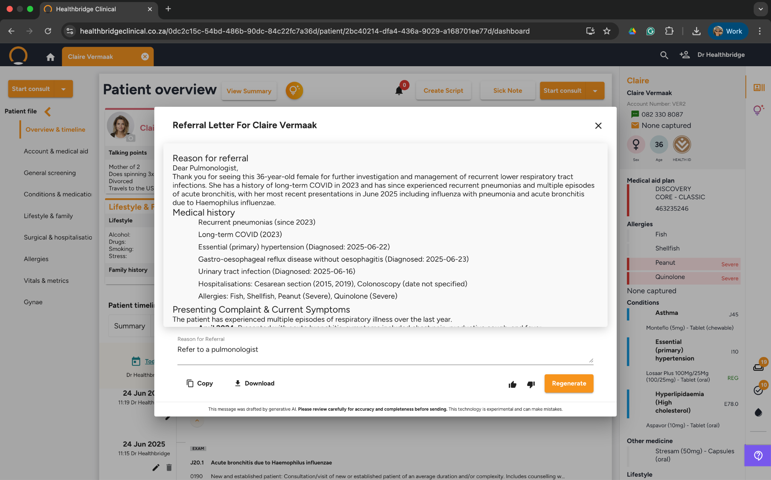
Referral
Notes:
At this point I may want to refer Claire to an Pulmonologist given her recurring upper respiratory issues. AI takes the context of the ENT referral and prepares the referral which can be reviewed, amended if needed and then sent.

Slide 20
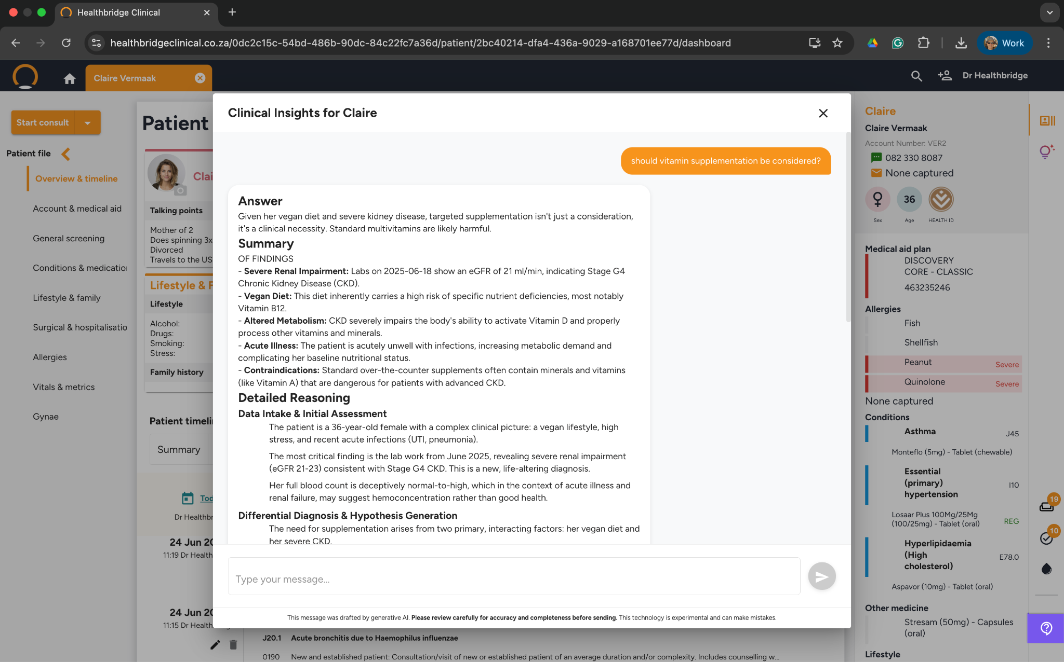
Clinical Insights
Notes:
Lastly, AI makes it possible to do a deep dive into a patient’s history, think of it as ChatGPT for a specific patient.
So in the case of Claire, let’s see if there any reason for suspecting vitamin deficiencies. The fact that Claire is vegan, is deeply hidden in her clinal record and may have been lost in conversations between her doctor and herself.
But AI points out, that careful attention however is needed while the kidney issue is presented.

Slide 21
Lessons learnt

Slide 22

The Job To Be Done ≠ “AI”; ≠ ChatGPT
Intrinsic Cognitive Load
Understand patient complexity
Extraneous Cognitive Load
Navigate EHRs & AI tools
Germane Cognitive Load
Learn and commit to long-term memory

Slide 23









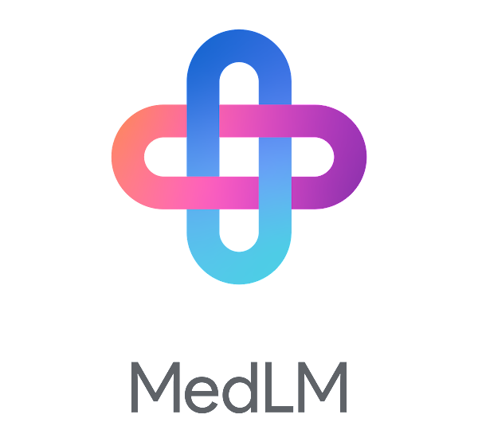


AI, a new and ever evolving capability
Audio Endpoint
Vertex AI
Healthbridge Clinical
Streaming Audio
Cloud Functions
Prompt Chain
Vertex AI
Monitoring
Transcription
Chirp
Gemma 2
LLM
Logging
MedLM ¹
LLM
Audio storage
Cloud Storage
Analytics store
BigQuery
Analytics Notebooks
Vertex AI

Slide 24
Next

Slide 25
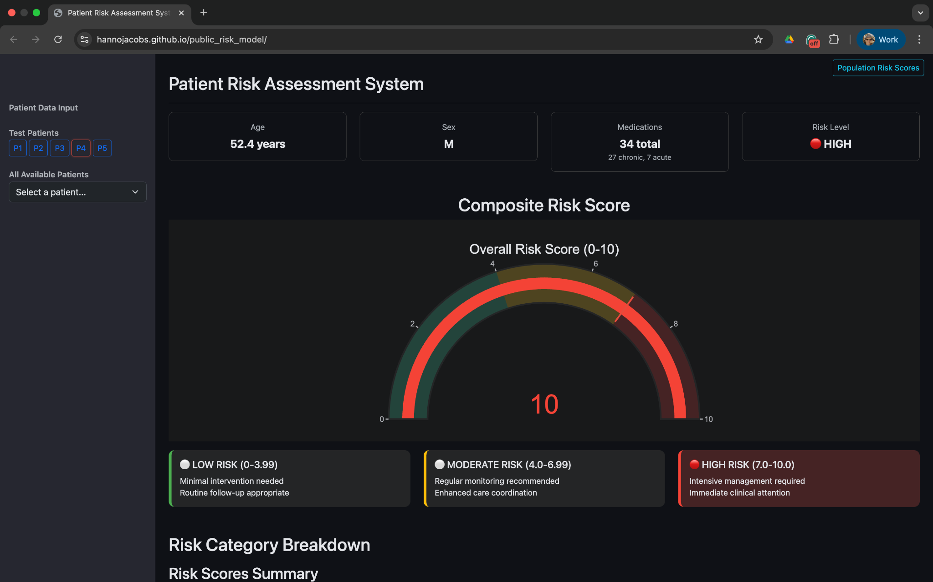
Patient Risk Assessment
Notes:
So, here we have a risk rating of individual patients, taking into consideration a number of factors.
Patient P1 has a relatively low risk, but P4 is significantly high.
This high rating is a result of a number factors, including an HbC . As keen be seen this patient has a long list of conditions and medications.

Slide 26
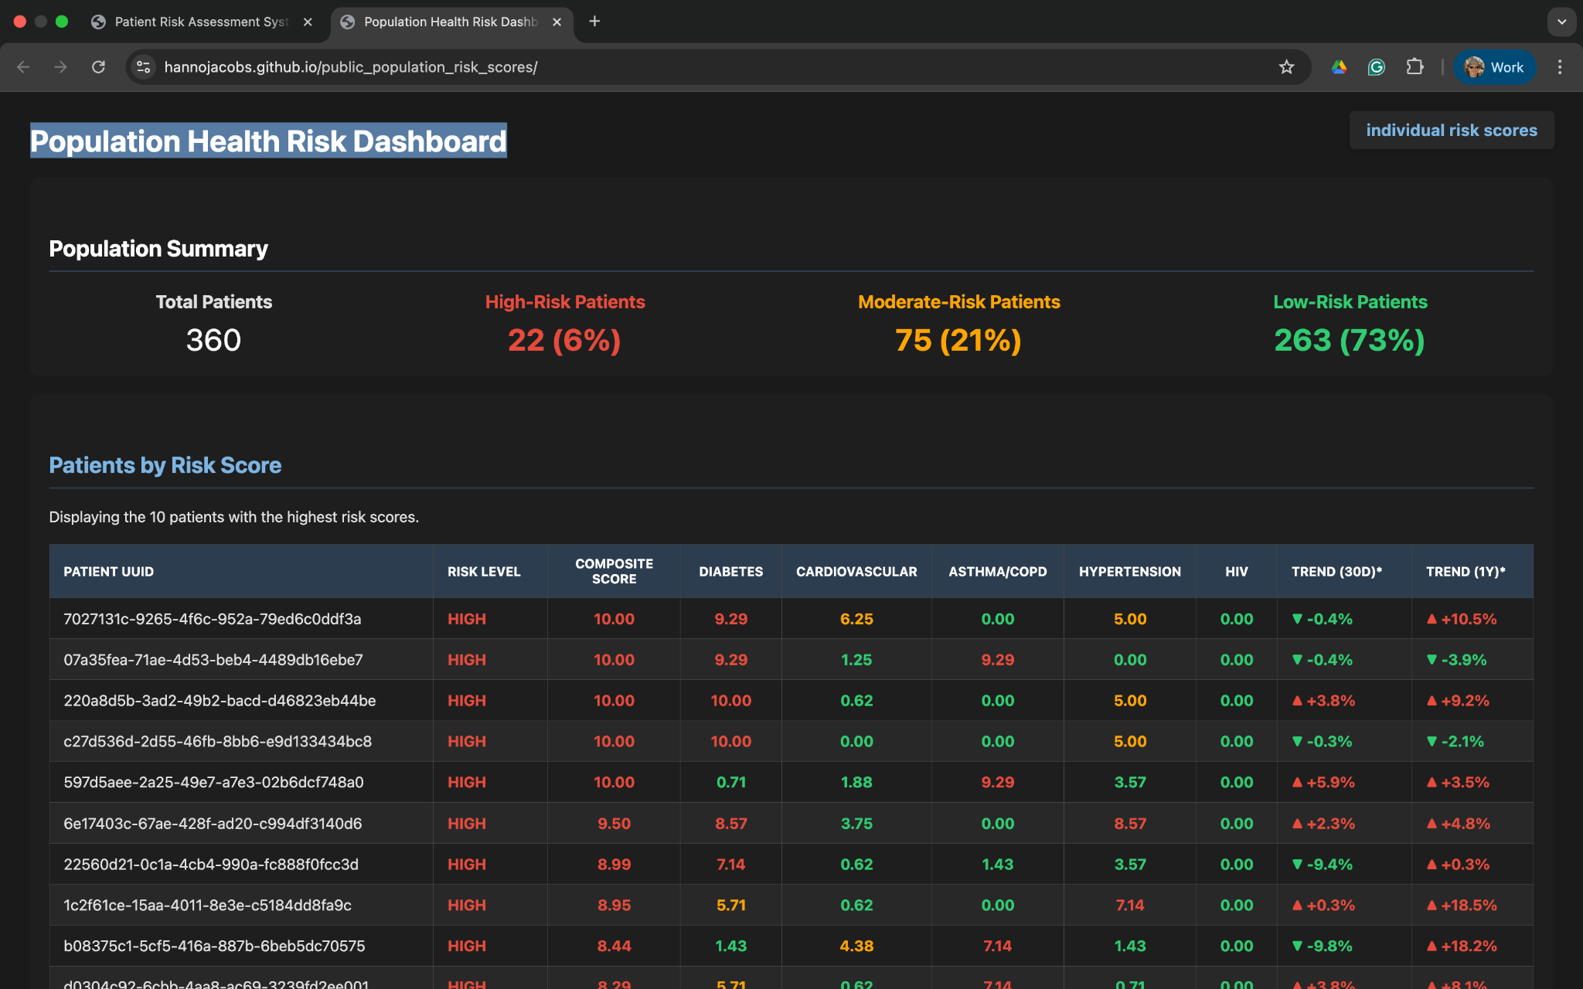
Population Health Risk Dashboard
Notes:
Now we can look a summary of the population this practice services. A break down of the categories is given as well as a count of the number conditions and patients in the various risk categories.
What s exceptionally powerful is that over time the trend of this population's health can be measured, a keep input for Value Based Care contracting going forward.
This Is just the beginning. A dashboard like this is useless in fact, it just creates more work for a really overworked doctor. With theA I tool seen today, the next step will be to trigger workflows and nudges to a care coordination team members and to the patient via the WhatsApp as engagement platform. That will be when the impact of the healthcare professionals will be amplified and scaled!!!

Slide 27
In closing

Slide 28
How AI can improve clinical outcomes
 | Predictive | Preventative | Personalised | Participatory | Precision
AI Patient Engagement via WhatsApp |  | ✔ | ✔ | ✔
AI Patient Summary for the Practitioner | ✔ | ✔ |  |  | ✔
AI Ambient Listening & Note Taking |  |  | ✔ | ✔ | ✔
AI Suggestive Meds |  | ✔ |  |  | ✔
AI Pathology Interpreter | ✔ |  | ✔ | ✔ | ✔
AI Referral Letter | ✔ |  | ✔ |  | ✔
AI Visit Summary for Patient |  |  | ✔ | ✔
AI Clinical Insights | ✔ | ✔ |  |  | ✔
The 6th P, AI Population Management

Slide 29
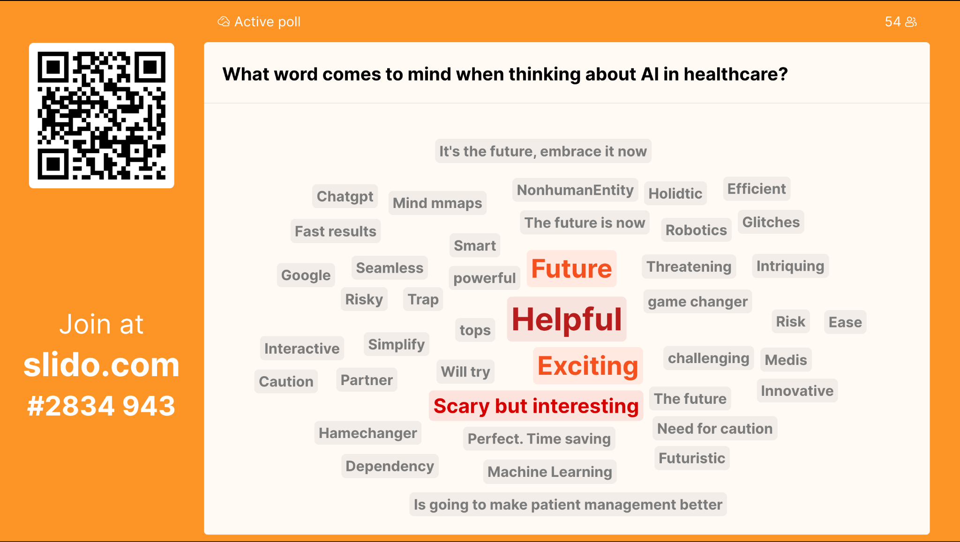

Slide 30
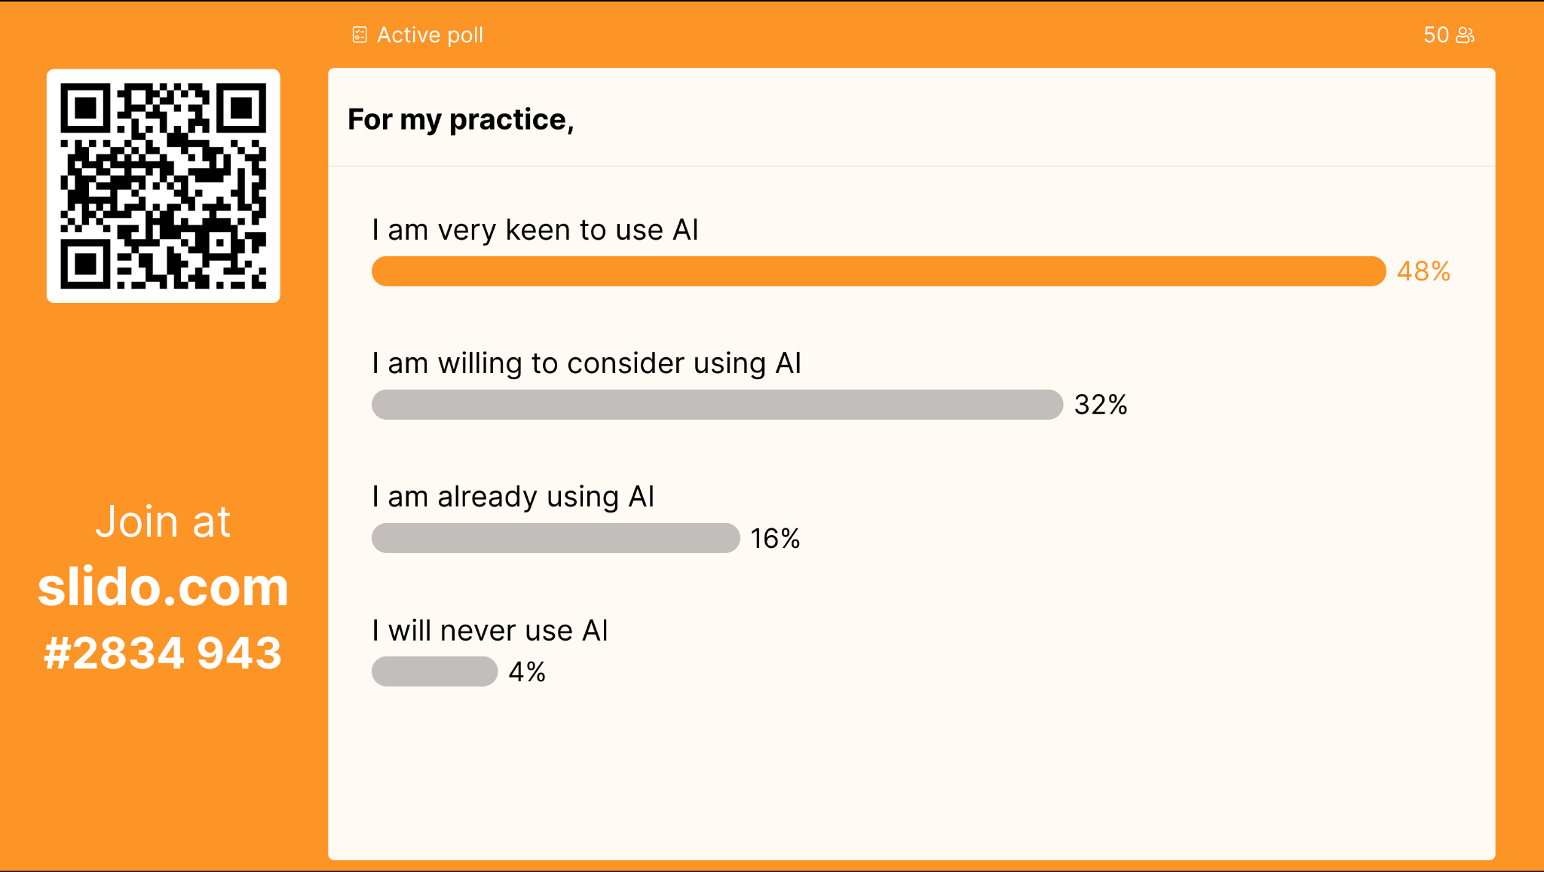

Slide 31
THANK YOU
We look forward to hosting you next year!

