Slide 2

Ishmael mogapi
Tackling Fraud, Waste & Abuse to Strengthen Affordability and Member Value

Slide 3
Agenda
01 | Governance and Empowering Provisions
02 | True Cost of Fraud, Waste & Abuse
03 | Section 59 Enquiry & GEMS Response
04 | A Look At Fraud, Waste & Abuse Within GEMS
05 | Industry Contribution Towards Sustainability

Slide 4
Governance and Empowering Provisions
Overview:
Section 7 MSA – CMS act in the interests of beneficiaries
Section57(2) MSA – Board of trustees are elected by the members
Section 57(4) MSA – duty of the board to protect beneficiary benefits and implement appropriate controls to manage and prevent FWA

Slide 5
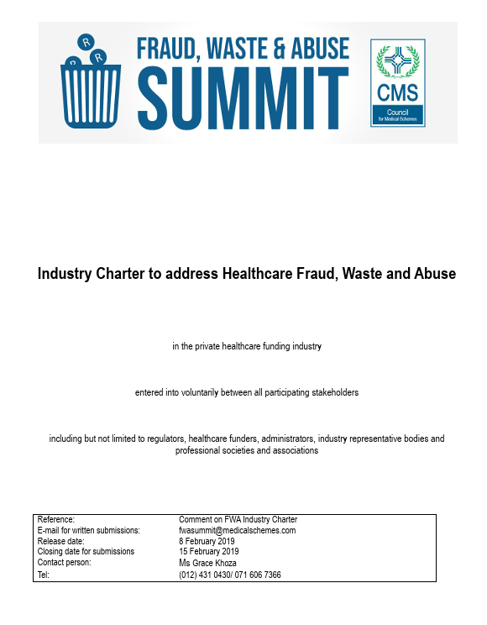
Trustees’ Responsibility towards FWA
Fraud, Waste And Abuse Code of Good Practice
Board of Trustees of a medical scheme is responsible for ensuring that –
• A medical scheme pays claims on time and those adequate methods to mitigate and control FWA are adopted and implemented.
• FWA policies are adopted and implemented, and records of processes performed are maintained.
• A person contracted to implement methods to prevent, detect, and investigate FWA comply with this CoGP and all applicable laws and instruments.
• Methods to prevent, detect, and investigate FWA are audited annually to review compliance with all industry-standard operating procedures.
Medical scheme trustees must have regular oversight of all FWA activities conducted on their behalf. This should include quarterly reporting.

Slide 6
Responsibility of the Medical Scheme
To act with integrity and honesty in dealing with providers of health care services, suppliers of healthcare products and beneficiaries.
To act in accordance with the Medical Schemes Act and other relevant laws.
To always treat providers of health care services and suppliers of health care products and beneficiaries fairly and in a manner that does not constitute unfair discrimination.
To co-operate with the relevant authorities, where applicable, in dealing with fraud, waste and abuse.
To act always in a manner that upholds a zero-tolerance stance towards fraud, waste and abuse.
To act in a manner that promotes and protects the financial sustainability of medical schemes.

Slide 7
True Cost of Fraud, Waste & Abuse
Threatens the sustainability of a medical scheme
Negatively impacts scheme’s ability to provide benefit rich plans at low cost
Diverts much needed funds away from intended purpose
Contributes to increased member contributions

Slide 8
Reserves
Medical schemes are required to have 25% of annual contributions received in reserve to ensure that they are always in a position to cover claims. The table below shows the amounts in reserve and the percentages of the annual contributions.
In 2016 the GEMS reserves were at alarming low levels, and the reasons for this will be discussed later in the presentation.
At year-end | 2014 | 2015 | 2016 | 2017 | 2018
Reserves | R2 659 261 857 | R2 796 484 962 | R2 033 840 389 | R5 404 088 371 | R9 368 823 132
Percentage | 10.03% | 9.94% | 6.55% | 15.22% | 24.45%

Slide 9
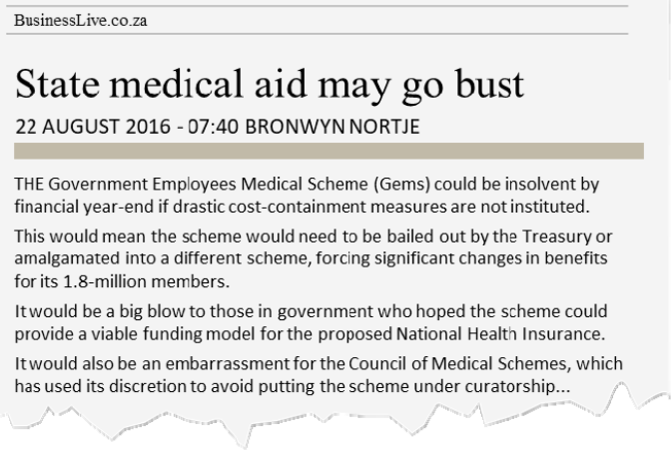
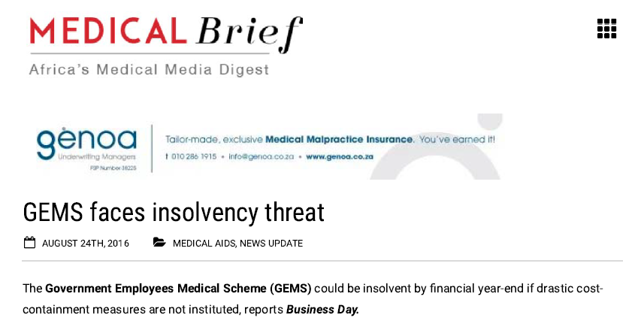
FWA threatens Scheme sustainability
Notes:
Instances of FWA did play a role in respect of the above, and the media frenzy created panic amongst GEMS members, as can be seen from some media reports on the next slide.

Slide 10
Claims Containment Project
The financial turnaround was driven by initiatives implemented by the Claims Management Forum

Slide 11
How FWA Prevention Adds Member Value
Financial Protection
Enhanced Security and Trust
Improved Member Experience
Reduced Operational Costs
Increased Confidence and Loyalty
Protection of Personal Information

Slide 12
Section 59 Enquiry & GEMS Response
• Triggered by allegations from NHCPA and Solutionist Thinkers Group (2019)
• CMS launched formal investigation into racial bias and procedural fairness
• Section 59 Interim Report released: January 2021
• Findings included: racial disparities in FWA outcomes, procedural gaps

Slide 13
GEMS Response Philosophy
• Open-door policy to provider associations and representative groups
• Strong belief in introspection and continuous improvement
• Emphasis on balancing fiduciary duty with fairness and stakeholder engagement
• Active engagement in CMS-led FWA policy reforms

Slide 14
Governance Reforms
• Revamped Claims Risk Sub-Forum and Forum Charter
01
• Independent oversight before remedial measures are applied
02
• Defined appeal and review mechanisms
03
• Audit Committee involvement in suspension of direct payment management and AOD reviews
04

Slide 15
Completed Operational Interventions
SOPs: New SOPs for FWA reviews and allegation assessments
Debt Policy: Flexible repayment terms and cooling-off period
Title Reform: From “Fraud/ Health Investigation' to ‘GEMS Claims Risk Management'
Affordability: Pre-AOD affordability assessments mandatory

Slide 16
CMS Code of Good Practice Alignment
• Working group participation
• Legal review input
• Tribunal advocacy
• Sanction registry collaboration

Slide 17

Forward-Looking Priorities
Provider Education
Contribution to Industry wide view of FWA Impact
Swifter action on proven fraud
Increase CMS and industry collaboration
Increase automation and early detection capabilities

Slide 18

A Look At Fraud, Waste & Abuse Within GEMS
The Scheme prioritises Fraud, Waste and Abuse preventions followed by remedial measures against offending employees, members and healthcare providers and the recovery of financial loss
The following practical steps affect the Scheme’s policy stance:
Implementing appropriate and extensive controls for the prevention and detection of Fraud Waste and Abuse
Investigate and report FWA incidents and
Imposing strict remedial measures and other remedies available

Slide 19
Managing Fraud Waste & Abuse
FWA Prevention
FWA Detection
FWA Response
Prevent payment of an illegitimate claim
Identify possible illegitimate claims
React to illegitimate claims
Clinical Risk Management
Benefit design
Clinical Protocols
Authorisation Protocols
Provider Engagement
Communication and education
Tariff negotiation
Networks
Member and Provider Advocacy
Communication and education
Pre-payment
Claims validation
Claims adjudication (rules)
Analytics
Links to sanctioned practices
Post-payment
Behavioural analytics
Whistle blower/hotlines
Industry information
Internal controls
Engage
Communicate to clarify any issues identified
Investigate
Peer benchmarking claims evaluation system
Investigation methodology
Engage provider/ member/ stakeholder
Take action
Recover
Remediate
Report
Repair

Slide 20
A Look At Fraud, Waste & Abuse Within GEMS
Analytics
Tip-offs
Industry Collaboration
1
Prevention (Proactive analytics, FWA awareness)
2
Detection (Reactive analytics, tip-offs)
3
Response (Investigation and actions)
Provider Engagement and/or Remedial Action

Slide 21
A Look At Fraud, Waste & Abuse Within GEMS
    At the core of GEMS’s commitment to deliver the best possible healthcare at the most affordable rates to its members is the need to mitigate risk, with specific reference to FWA.
    GEMS understands that FWA is driven through an individual or group of individuals’ need to act in a manner that may prejudice the Scheme, its beneficiaries and other providers, if this is not prevented.
    To explain why instances of FWA occur, the concept of the fraud triangle, which originated from Donald Cressey’s hypothesis, is referenced.

Slide 22

Case Study – Recruitment Scam

Slide 23
Industry Contribution Towards Sustainability
Set the tone right at the top
  Senior management and the board of Trustees should ensure that they promote a culture of collaboration
Improvements in data warehousing
  One of the core processes in a medical scheme with regard to data retention, trend analysis and risk management is the ability to have an effective data warehousing platform in place

Slide 24
Industry Contribution Towards Sustainability
Carry out Medical Schemes’ Anti-Fraud Survey
  To measure the response to fraud and to consider trends in terms of prevalence and frequency
Create a culture of enforcement and accountability
  Schemes should consider enhancing their policies and protocols to include elements of enforcement and accountability that are not punitive

Slide 25

Industry Contribution Towards Sustainability
Fraud is too organised to fight alone, it takes collective action to protect our members!

Slide 26
THANK YOU
We look forward to hosting you next year!

